Slide 1
Answering Some Skeptics Questions Can Be Exhausting
Focus on 1st Importance [1 Cor 15:12-19]

Slide 2
Answering Some Skeptics Questions Can Be Exhausting
There are multiple sources:
Greek, Roman, Jewish, & Christian
Adequate archaeological evidence.
There are conversions of:
Skeptics & relatives, 500 eyewitnesses
Their chief witness: women.
He died & His tomb was empty.
Focus on 1st Importance [1 Cor 15:12-19]

Slide 3
Will Christianity Make Me Happy?
Is it mean to say Jesus is the ONLY way?
Can I Trust The Bible?
How does God view time?

Slide 4
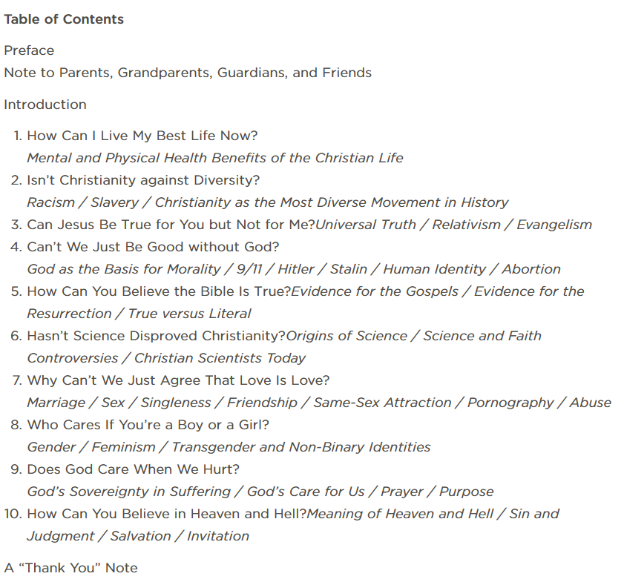
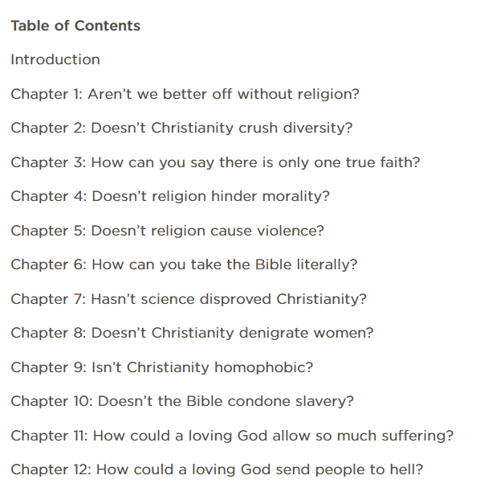
Christians Can Ask & Answer Hard Questions

Slide 5
What About Hell?
“There is no doctrine which I would more willingly remove from Christianity than this, if it lay in my power. But it has the full support of Scripture and, specially, of our Lord’s own words; it has always been held by Christendom.”
C. S. Lewis The Problem of Pain

Slide 6
What About Hell?
A) What Did Jesus Teach About Hell?
1) Jesus warned of the “furnace of fire” Mt 13:42, the “eternal fire” Mt 18:8, the “unquenchable fire” Mk 9:43, & the “fiery Hell” Mt 5:22. He likened the fire to Gehenna, where “their worm does not die, & the fire is not quenched” Mk 9:48.
2) Jesus gave CLEAR expectations: [Matt 24:45-51; 25:26-30].
We can DO His will. Believe & obey Jn 3:36; Love & obey Jn 14.
3) Literal phrase: “eternal punishment” [Mt 25:31-34, 41-46].
4) He endorsed God’s Love & Wrath as compatible:
[Psalm 145:17-20] God’s Love motivates His vengeance.

Slide 7
What About Hell?
A) Jesus Clearly Taught On Hell. Mt 24-25
B) Philosophical Questions to Consider:
1) Is God Fair to Judge Us? Why do we expect this of God? In one sense He isn’t…
He lets His enemies (us), freely choose trust. [Rom 5:6-11] Thus, “All that are in hell chose it.” C.S. Lewis
2) Does Belief In Hell Improve Humanity?
A final state of justice fulfills human longing, addresses evil. Hell is a great motivator for right living. [Romans 12:19]

Slide 8
What About Hell?
A) Jesus Clearly Taught On Hell. Mt 24-25
B) Philosophical Questions to Consider:
1) Is God Fair to Judge Us? It’s a choice [Rom 5:6-11] 2) Does Belief In Hell Aid Humanity? Motivation [Rom 12:19]
3) What Do Other Cultures Believe About Hell?
Why should Western concerns determine truth? Some Eastern cultures are offended at grace & mercy. Is it narrow-minded to caution about consequences?

Slide 9
What About Hell?
A) Jesus Clearly Taught On Hell. Mt 24-25
B) Philosophical Questions Can Favor Hell. Rom 5, 12
C) We’re Created for Relationships
The self-centered foolishly dismiss God. [Lk 16:19-31] Paul says Hell is separation from our Creator. [2 Th 1:6-10]
Consider the titles of The One giving the invitation: (John)
Bread of Life, Light of the World, The Way & The Life…
Why choose to be hungry & lost in a dark & dead place?

