Slide 1
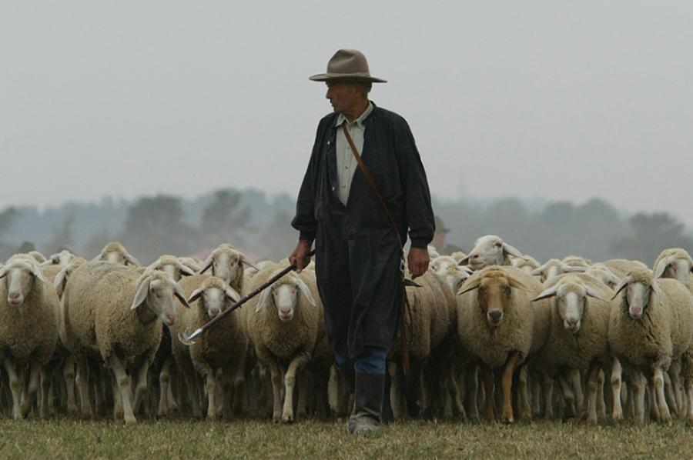
Looking for Shepherds

Slide 2
Make Every Effort To Maintain unity
A Study of Ephesians 4:1-6
What Makes For A Worthy Life? [4:1-3]
A worthy life will invest energy into God’s unity plan.
What We Must Be United On [4:4-6]
“Unity in essentials, liberty in incidentals, & in all things love.”
What We Will NOT Be United On:
We can’t be united on telling lies (untruths). We can’t be united on walking in darkness.
We won’t be united on the 100s of Christian opinions.
In Revelation, Ephesus was praised for testing true apostles. In Eph 4 church leadership immediately follows the unity list.
In 1 Timothy, Paul wants elders appointed at Ephesus.

Slide 3
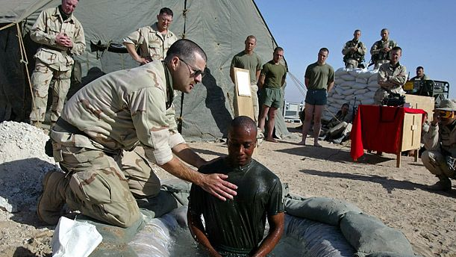
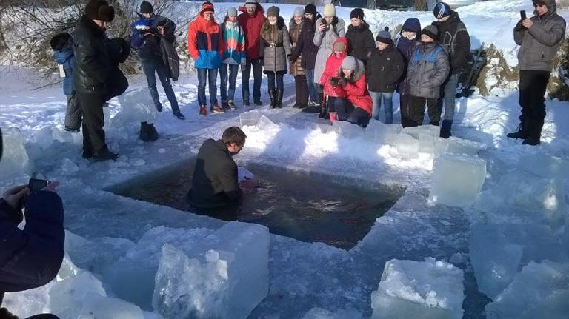
Leadership In The New Testament
1) Leaders were EARLY, among both GENTILE & JEW.
Ac14:11-16, 23, 27; Titus 1:3-12; 1Th 5:12-14; 1:9-10, 2:13-16
2) Leadership was NEVER just ONE. Cf. [3 John 9-10]
Php 1:1; Acts 14:23; 1 Tim 3; Titus 1; 1 Pet 5; Heb 13:17-21; James 5:14
3) Church Leaders had VARIOUS TITLES. (synonyms)
Notice where the word is interchangeable: [Acts 20:17, 28]
Elders (presbuteros); Overseers (episkopi); Shepherd (poimen). Sometimes overseer=bishop & shepherd=pastor.
This interchange happens in [Titus 1:5,7 & 1 Pet 5:1-5].
Overseer Virtues
2 Pet 1:5-11
Being eager to obey, doesn’t mean we’re so desperate we’ll just pour or sprinkle, neither should we be so desperate we just appoint anyone. There will need to be grace-filled hard conversations about 1 Timothy 3 & Titus 1.

Slide 4
Biblical Virtues of a Leader
1) Biblically, they’re human & humans sin.
Think about this with Ephesus [Acts 20:17, 28-32].
To Timothy in Ephesus notice [1 Tim 5:17-25].
Paul presupposes elders will sin & some will persist!
We must keep these rules without partiality.
Sins of some people take a while to become public.

Slide 5
Biblical Virtues of a Leader
1) Biblically, they’re human & humans sin.
Think about this with Ephesus [Acts 20:17, 28-32].
Paul says some elders will persist in sin [1 Tim 5:17-25]!
Jesus knew the OT religious leader track record.
Expresses stern concern [Mt23:29-39;Mk12:24, 38-40]
Even the apostle Peter joined in sin with Barnabas.

Slide 6
Biblical Virtues of a Leader
1) Biblically, they’re human & humans sin.
Think about this with Ephesus [Acts 20:17, 28-32].
Paul says some elders will persist in sin [1 Tim 5:17-25]!
Jesus saw leader flaws: [Mt23:29-39;Mk12:24, 38-40].
2) We aren’t looking for perfection.
We need grace filled assessment of self & others.
Churches need humble realistic leaders, open to criticism.
This is a critical character trait of maturing elders.

Slide 7
Biblical Virtues of a Leader
1) Biblically, they’re human & humans sin.
Ephesus heresy [Ac 20:28-32]. Persist in sin [1 Tim 5:17-25]!
2) We aren’t looking for perfection. Grace-filled judgments.
Biblical maturing elders will be humble & open to criticism.
3) Why is agreement hard on 1 Tim 3 & Titus 1 lists?
They aren’t easily measured. People mis-use the lists. People aren’t consistent in how they apply the standards. We’re tempted to add reasons to some that aren’t there. We’ve all been brought up with different experiences.

Slide 8
Biblical Virtues of a Leader
If Paul’s emphasis serves as a summary, it’s this:
1 Timothy 3
Therefore, an overseer must be above reproach, the husband of one wife, sober-minded, self-controlled, respectable, hospitable, able to teach, ³ not a drunkard, not violent but gentle, not quarrelsome, not a lover of money. ⁴ He must manage his own household well, with all dignity keeping his children submissive, ⁵ for if someone does not know how to manage his own household, how will he care for God's church? ⁶ He must not be a recent convert, or he may become puffed up with conceit and fall into the condemnation of the devil. ⁷ Moreover, he must be well thought of by outsiders, so that he may not fall into disgrace, into a snare of the devil.
Titus 1
Put things in order… If anyone is above reproach, the husband of one wife, and his children are believers and not open to the charge of debauchery or insubordination. 7 For an overseer, as God's steward, must be above reproach. He must not be arrogant or quick-tempered or a drunkard or violent or greedy for gain, 8 but hospitable, a lover of good, self-controlled, upright, holy, and disciplined. 9 He must hold firm to the trustworthy word as taught, so that he may be able to give instruction in sound doctrine and also to rebuke those who contradict it.
Each letter has a unique Greek word behind it. Many translations say: Blameless (like Job). The same word is used in [1 Tim 5:7 & 6:14]. It’s the goal for ALL saints in [Col 1:21-22].

