Slide 1
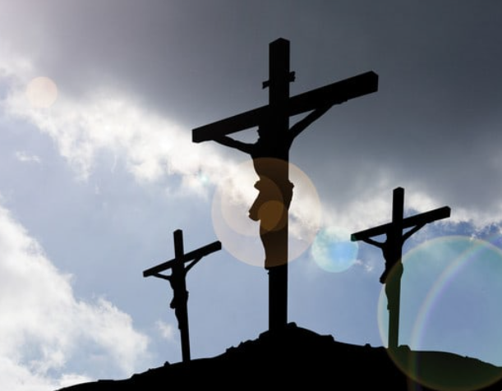
Three Crosses Three Men
Luke 23:26-47

Slide 2
Three Crosses
Of the three, one in the middle is most important
Isaiah (Isa 52:13 – 53:12) drew picture of the crucifixion 700 years before it happened
Made Christ’s cross most prominent in careful detail
Stated Jesus would be “numbered with the transgressors”
Two other crosses on which thieves were crucified not given same importance
Luke’s gospel (23:26-47) tells story behind three crosses
Rejection
Repentance
Redemption

Slide 3
Background
Cross has become a symbol
We see payment for our sins
Full price of redemption
Words of Jesus’ enemies, those crucified with Him, and His own words remind of facts concerning the one who died on the cross in the middle
Enemies and rulers—hatred, insults and sarcasm
With Him—one selfish and one rebuking & repentant
Jesus—love and forgiveness

Slide 4
Cross of Rejection
Not everyone saw Christ as redeemer
Troublemaker or imposter
Helpless king dying a hopeless death
Summarizes all who reject Jesus—hurled insults and mockery
Listened to the crowd, rulers, and soldiers?
Experiences? Angry at the world?
Hiding a life of sin behind hatred?
Serves as our warning
Don’t listen to the crowds—still ridiculing Jesus
Satan at work

Slide 5
Man of Rejection
Thief was hanging on the cross and could blaspheme all he wanted—he was condemned to death
Represents world that wants to be saved without acknowledging the judgment
If You are the Messiah, take away the judgment; let us escape and You with us
Show us what you can do

Slide 6
Cross of Repentance
Thief on this cross saw that Jesus was innocent
Initially, made fun of Jesus but was led to see truth
Not necessarily a nicer guy than other criminal
Didn’t listen to crowds, soldiers, or his experiences
Rebuked the other criminal
This cross convicts us of our sins and connects us to His cross of redemption

Slide 7
Man of Repentance
This thief was willing to suffer for the evil deeds he had done so he could be freed from them (Luke 23:40-41)
Freed from his burden of sin through acknowledgment and judgment
Received assurance that he would be with Jesus in paradise (Luke 23:42-43)

Slide 8
Cross of Redemption
God chose his Son to bring salvation to mankind (Col 1:19-20)
God balanced the books of His justice on it
God planned to let his anger at sin and all of sin’s consequences to fall on Jesus (Gal 3:13)
Jesus bore our sins in his body on the tree… (1 Pet 2:24)

Slide 9
Man of Redemption
None other than Jesus Himself
Took our sins on His body—was made sin for us
God did what was impossible for the law—He condemned sin in Christ’s flesh (Rom 8:3)
When this work was finished, Jesus gave up his spirit

Slide 10
Three Crosses
One holds a man dying for sin (redemption)
One holds a man dying in sin (rejection)
One holds a man dying to sin (repentance)
We are allowed to see and hear the message of the cross in the middle, the cross of redemption

