Slide 1
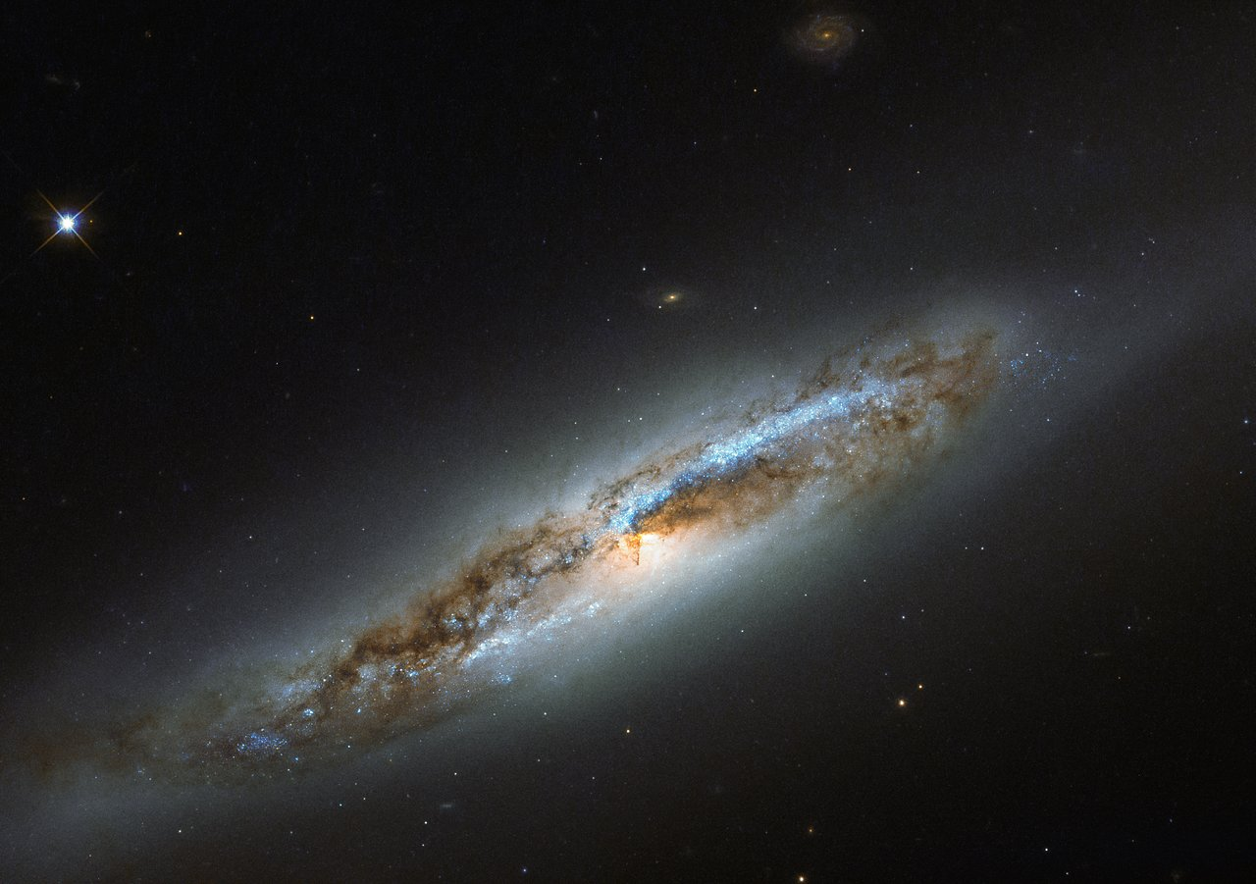

Slide 2
Jeremiah 9.23,24
Thus says the LORD, “Let not a wise man boast of his wisdom, and let not the mighty man boast of his might, let not a rich man boast of his riches; but let him who boasts boast of this, that he understands and knows Me, that I am the LORD who exercises lovingkindness, justice and righteousness on earth; for I delight in these things,” declares the LORD.
NASB95

Slide 3
REVELATION 4.8
And the four living creatures, each one of them having six wings, are full of eyes around and within; and day and night they do not cease to say, “HOLY, HOLY, HOLY IS THE LORD GOD, THE ALMIGHTY, WHO WAS AND WHO IS AND WHO IS TO COME.”
NASB95

Slide 4
REVELATION 4.9-11
And when the living creatures give glory and honor and thanks to Him who sits on the throne, to Him who lives forever and ever, the twenty-four elders will fall down before Him who sits on the throne, and will worship Him who lives forever and ever, and will cast their crowns before the throne, saying,
NASB95

Slide 5
REVELATION 4.9-11
“Worthy are You, our Lord and our God, to receive glory and honor and power; for You created all things, and because of Your will they existed, and were created.”
NASB95

Slide 6
God is Creator
The Significance & Consequence

Slide 7
Context of Rev. 4.11
24 Elders’ Worship (Rev. 4.11)
Elders SEEM to represent faithful humanity
Cast THEIR crowns at the Creator’s feet
Worthy of “glory and honor and power”

Slide 8
Context of Rev. 4.11
3 Reasons
FOR You Created ALL THINGS
BECAUSE of Your will, they “were”
And “were created”

Slide 9
Context of Rev. 4.11
3 Reasons
Created All Things – Worthy of Power
Your will, they “were” – Worthy of Honor
“were created” – Worthy of Glory

Slide 10
The Wonder of the Creator

Slide 11
How Can Almighty Receive Power?
Almighty (All Authority) Includes “power”

Slide 12
Isaiah 45.23,24
²³ “I have sworn by Myself,
The word has gone forth from My mouth in righteousness
And will not turn back,
That to Me every knee will bow, every tongue will swear allegiance.
NASB95

Slide 13
Isaiah 45.23,24
²⁴ “They will say of Me, ‘Only in the LORD are righteousness and strength.’
Men will come to Him,
NASB95

Slide 14
How Can Almighty Receive Power?
Almighty (All Authority) Includes “power”
Every knee will bow? Will swear allegiance?

Slide 15
Isaiah 44.21,22
“Remember these things, O Jacob,
And Israel, for you are My servant;
I have formed you, you are My servant,
O Israel, you will not be forgotten by Me.
NASB95

Slide 16
Isaiah 44.21,22
²² “I have wiped out your transgressions like a thick cloud
And your sins like a heavy mist.
Return to Me, for I have redeemed you.”
NASB95

Slide 17
How Can Almighty Receive Power?
Almighty (All Authority) Includes “power”
Every knee will bow? Will swear allegiance?
Return to the Creator?
God gave angels and humans power to reject Him
Creator ought to be given that power back
I.e. humans ought to cast their crowns before God

Slide 18
WHY Worthy of Power?
Is. 51.12,13
Vs. 9-11
“Put on strength” as in “past generations”
Cut Rahab (the sea dragon) in pieces
Made a path through the waters
Recalling God’s past deliverance

Slide 19
Isaiah 51.12,13
Is. 51:12 “I, even I, am He who comforts you.
Who are you that you are afraid of man who dies
And of the son of man who is made like grass,
¹³ That you have forgotten the LORD your Maker,
Who stretched out the heavens
NASB95

Slide 20
Isaiah 51.12,13
And laid the foundations of the earth,
That you fear continually all day long because of the fury of the oppressor,
As he makes ready to destroy?
But where is the fury of the oppressor?
NASB95

Slide 21
WHY Worthy of Power?
Is. 51.12,13
Why is anyone afraid of man?
Have you forgotten your Maker?

Slide 22
WHY Worthy of Power?
Is. 51.12,13
B/C only Creator can guarantee deliverance
B/C to NOT entrust our Power to Him IS to FORGET our Creator
B/C my power is ONLY effective if Given to the Creator

Slide 23
Job 40.15-24
Job 40:15 “Behold now, Behemoth, which I made as well as you;
He eats grass like an ox.
¹⁶ “Behold now, his strength in his loins
And his power in the muscles of his belly.
¹⁷ “He bends his tail like a cedar;
NASB95

Slide 24
Job 40.15-24
The sinews of his thighs are knit together.
¹⁸ “His bones are tubes of bronze;
His limbs are like bars of iron.
Job 40:19 “He is the first of the ways of God;
Let his maker bring near his sword.
²⁰ “Surely the mountains bring him food,
NASB95

Slide 25
Job 40.15-24
And all the beasts of the field play there.
²¹ “Under the lotus plants he lies down,
In the covert of the reeds and the marsh.
²² “The lotus plants cover him with shade;
The willows of the brook surround him.
²³ “If a river rages, he is not alarmed;
NASB95

Slide 26
Job 40.15-24
He is confident, though the Jordan rushes to his mouth.
²⁴ “Can anyone capture him when he is on watch,
With barbs can anyone pierce his nose?
NASB95

Slide 27
WHY Worthy of Power?
Job 40.15-24
Made the Behemoth just like you Job
Immensity of power shows 2 things
Power of Initial Creation
Power of Continued Control

Slide 28
WHY Worthy of Power?
Job 40.15-24
Made the Behemoth just like you Job
“First of the ways of God”
What is contrasted by Behemoth’s power?
Power & PEACE merged in this creature
B/C Creator’s Power reigned in by Peace

Slide 29
WHY Worthy of Power?
Is.48.6-8
Recall vs. 3-5
God foretells His actions & suddenly acts
To prove uniqueness from idols
Their rebellious hearts

Slide 30
Isaiah 48.6-8
⁶ “You have heard; look at all this.
And you, will you not declare it?
I proclaim to you new things from this time,
Even hidden things which you have not known.
NASB95

Slide 31
Isaiah 48.6-8
⁷ “They are created now and not long ago;
And before today you have not heard them,
So that you will not say, ‘Behold, I knew them.’
NASB95

Slide 32
Isaiah 48.6-8
⁸ “You have not heard, you have not known.
Even from long ago your ear has not been open,
Because I knew that you would deal very treacherously;
And you have been called a rebel from birth.
NASB95

Slide 33
WHY Worthy of Power?
Is.48.6-8
Creates NEW Things
(Again) Because of their rebellious hearts
Proves Uniqueness from Humans; “I knew them”
Humans cannot create like God

Slide 34
Exodus 34.10
Then God said, “Behold, I am going to make a covenant. Before all your people I will perform miracles which have not been produced in all the earth nor among any of the nations; and all the people among whom you live will see the working of the LORD, for it is a fearful thing that I am going to perform with you.
NASB95

Slide 35
Numbers 16.30
“But if the LORD brings about an entirely new thing and the ground opens its mouth and swallows them up with all that is theirs, and they descend alive into Sheol, then you will understand that these men have spurned the LORD.”
NASB95

Slide 36
Psalm 139.13-16
For You formed my inward parts;
You wove me in my mother’s womb.
¹⁴ I will give thanks to You, for I am fearfully and wonderfully made;
Wonderful are Your works,
NASB95

Slide 37
Psalm 139.13-16
And my soul knows it very well.
¹⁵ My frame was not hidden from You,
When I was made in secret,
And skillfully wrought in the depths of the earth;
¹⁶ Your eyes have seen my unformed substance;
NASB95

Slide 38
Psalm 139.13-16
And in Your book were all written
The days that were ordained for me,
When as yet there was not one of them.
NASB95

Slide 39
WHY Worthy of Power?
Is.48.6-8
Creates NEW Things
New Covenants & Miracles (Ex. 34.10)
New Judgments (Num. 16.30)
New People & Personalities (Ps. 139.13-16)

Slide 40
What Do we DO? Wondering at the Creator
Act consistent to allegiance to the Creator
Make Time Worship and Wonder at the Creator
Psalm 104

