Slide 1
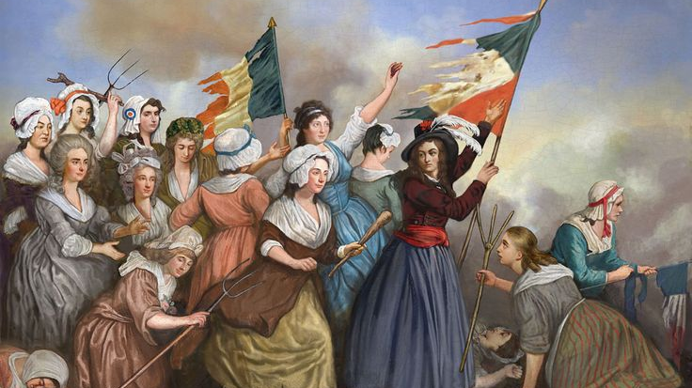
Recovering a revelation hymn
Glimpses of the throne room of God!

Slide 2
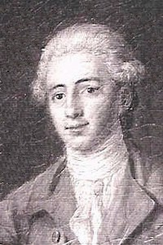
Recovering A Revelation Hymn
Edward Perronet (1726-1792)
French Huguenot Refugee (Protestant)
Worked with Anglicans & Methodists
Eventually became an independent
Wrote, “All Hail The Power of Jesus’ Name”
To some, “The National Anthem of Christendom”
Uses imagery of The Prophets & The Revelation

Slide 3
Recovering A Revelation Hymn
-All hail the power of Jesus' name!
Let angels prostrate fall;
bring forth the royal diadem,
and crown Him Lord of all.
-Let highborn seraphs tune the lyre,
and as they tune it, fall.
Before His face Who tune their choir,
And crown Him Lord of all.
Falling to the ground is an ancient sign of humility to superiors. Rev 1:9 & [22:8-9]
May God help us to be humble before His mighty throne!
Jesus, the conductor of an orchestra of angels! [Rev 15:1-4 & 14:1-5]

Slide 4
Recovering A Revelation Hymn
-Crown Him, ye martyrs of your God,
who from His altar call;
Extol the stem-of-Jesse’s rod,
& crown Him Lord of all.
-Sinners, whose love can ne'er forget,
the wormwood and the gall,
go spread your trophies at His feet,
and crown Him Lord of all.
The martyrs of [Rev 6:9-11 & 7:13-17] & cf. Isa 11:1-10
Learn what a hymn refers to!
“Wormwood” I need to study.
Mt 27:34 records Jesus’ last drink of gall fulfilling Psm 69:21

Slide 5
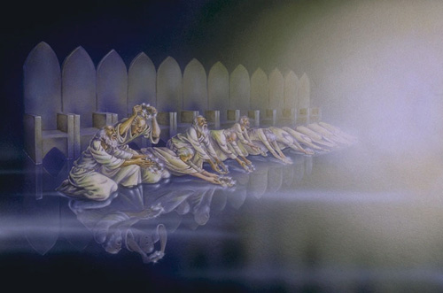
Recovering A Revelation Hymn
1 All hail the power of Jesus' name!
Let angels prostrate fall;
Bring forth the royal diadem,
And crown Him Lord of all.
2 Let highborn seraphs tune the lyre,
And as they tune it, fall.
Before His face Who tune their choir,
And crown Him Lord of all.
3 Crown Him, ye martyrs of your God,
Who from His altar call;
Extol the stem-of-Jesse’s rod,
And crown Him Lord of all.
4 Sinners, whose love can ne'er forget,
The wormwood and the gall,
Go spread your trophies at His feet,
And crown Him Lord of all.
5 Let every tribe and every tongue
Before Him prostrate fall;
And shout in universal song
The Crownèd Lord of All.
[Rev 7:9-12] 4:10; 6:2; 14:14, & 19:12

