Slide 2
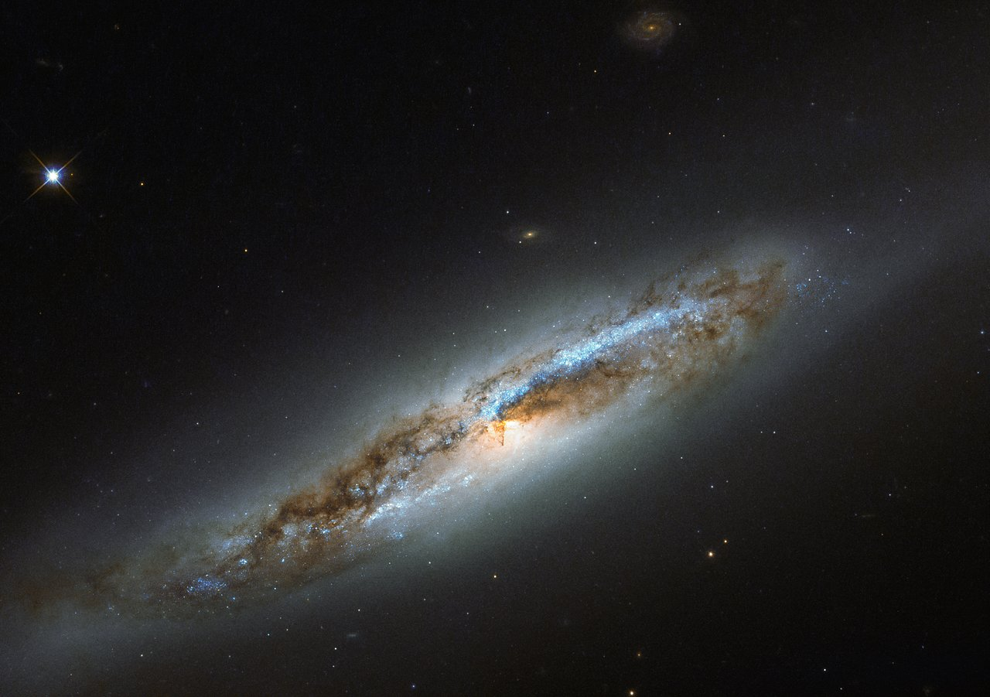
Jeremiah 9.23,24
NASB95
Thus says the LORD, “Let not a wise man boast of his wisdom, and let not the mighty man boast of his might, let not a rich man boast of his riches; but let him who boasts boast of this, that he understands and knows Me, that I am the LORD who exercises lovingkindness, justice and righteousness on earth; for I delight in these things,” declares the LORD.

Slide 3
REVELATION 4.8
And the four living creatures, each one of them having six wings, are full of eyes around and within; and day and night they do not cease to say, “HOLY, HOLY, HOLY IS THE LORD GOD, THE ALMIGHTY, WHO WAS AND WHO IS AND WHO IS TO COME.”
NASB95

Slide 4
REVELATION 4.8
And the four living creatures, each one of them having six wings, are full of eyes around and within; and day and night they do not cease to say, “HOLY, HOLY, HOLY IS THE LORD GOD, THE ALMIGHTY, WHO WAS AND WHO IS AND WHO IS TO COME.”
NASB95

Slide 5
God is Eternal
The Significance & Consequence

Slide 6
What Does “Eternal” Mean?
Difficult to Comprehend
Outside of Our Experience
Time Part of Our Physical Universe
2 Pet. 3.8; Is. 43.10

Slide 7
2 Peter 3.8
But do not let this one fact escape your notice, beloved, that with the Lord one day is like a thousand years, and a thousand years like one day.
NASB95

Slide 8
What Does “Eternal” Mean?
Difficult to Comprehend
2 Pet. 3.8; Is. 43.10
Supra-Time
Universe
(Physical Time)
GOD

Slide 9
Is. 43.10
…And understand that I am He.
Before Me there was no God formed,
And there will be none after Me.
NASB95

Slide 10
What Does “Eternal” Mean?
Difficult to Comprehend
2 Pet. 3.8; Is. 43.10

Slide 11
What’s In A Name?
Ex. 3.13-15; 6.2,3

Slide 12
Exodus 3.13-15
Ex. 3:13 Then Moses said to God, “Behold, I am going to the sons of Israel, and I will say to them, ‘The God of your fathers has sent me to you.’ Now they may say to me, ‘What is His name?’ What shall I say to them?” ¹⁴ God said to Moses, “I AM WHO I AM”; and He said, “Thus you shall say to the sons of
NASB95

Slide 13
Exodus 3.13-15
Israel, ‘I AM has sent me to you.’” ¹⁵ God, furthermore, said to Moses, “Thus you shall say to the sons of Israel, ‘The LORD, the God of your fathers, the God of Abraham, the God of Isaac, and the God of Jacob, has sent me to you.’ This is My name forever, and this is My memorial-name to all generations.
NASB95

Slide 14
What’s In A Name?
Ex. 3.13-15; 6.2,3
God’s Response: “I AM WHO I AM”

Slide 15
What’s In A Name?
Ex. 3.13-15; 6.2,3
God’s Response: “I AM WHO I AM”
hwhy - YHWH; hyh - HAYAH;

Slide 16
What’s In A Name?
Ex. 3.13-15; 6.2,3
God’s Response: “I AM WHO I AM”
hwhy - YHWH; hyh - HAYAH;
Gen. 27.29 – hwh

Slide 17
Exodus 6.2,3
Ex. 6:2 God spoke further to Moses and said to him, “I am the LORD; ³ and I appeared to Abraham, Isaac, and Jacob, as God Almighty, but by My name, LORD, I did not make Myself known to them.
NASB95

Slide 18
John 8.56-58
⁵⁶ “Your father Abraham rejoiced to see My day, and he saw it and was glad.” ⁵⁷ So the Jews said to Him, “You are not yet fifty years old, and have You seen Abraham?” ⁵⁸ Jesus said to them, “Truly, truly, I say to you, before Abraham was born, I am.”
NASB95

Slide 19
What’s In A Name?
Ex. 3.13-15; 6.2,3 – “I AM WHO I AM”
Ex. 34.6,7; Malachi 3.6

Slide 20
Exodus 34.6,7
⁶ Then the LORD passed by in front of him and proclaimed, “The LORD, the LORD God, compassionate and gracious, slow to anger, and abounding in lovingkindness and truth; ⁷ who keeps lovingkindness for thousands, who forgives iniquity, transgression and sin; yet He will by no means leave
NASB95

Slide 21
Exodus 34.6,7
the guilty unpunished, visiting the iniquity of fathers on the children and on the grandchildren to the third and fourth generations.”
NASB95

Slide 22
Malachi 3.6
For I, the LORD, do not change; therefore you, O sons of Jacob, are not consumed.
NASB95

Slide 23
ETERNAL MEANS…
Ex. 3.13-15; 6.2,3 – “I AM WHO I AM”
Ex. 34.6,7; Malachi 3.6 – Permanent Nature
Psalm 9.7,8; Is. 40.27,28

Slide 24
Psalm 9.7,8
Psa. 9:7 But the LORD abides forever;
He has established His throne for judgment,
⁸ And He will judge the world in righteousness;
He will execute judgment for the peoples with equity.
NASB95

Slide 25
Isaiah 40.27
Why do you say, O Jacob, and assert, O Israel,
“My way is hidden from the LORD,
And the justice due me escapes the notice of my God”?
NASB95

Slide 26
Isaiah 40.28
²⁸ Do you not know? Have you not heard?
The Everlasting God, the LORD, the Creator of the ends of the earth
Does not become weary or tired.
His understanding is inscrutable.
NASB95

Slide 27
ETERNAL MEANS…
Ex. 3.13-15; 6.2,3 – “I AM WHO I AM”
Ex. 34.6,7; Malachi 3.6 – Permanent Nature
Psalm 9.7,8; Is. 40.27,28 – Permanent Judge
Psalm 9.9,10; Is. 40.29,30

Slide 28
Psalm 9.9,10
⁹ The LORD also will be a stronghold for the oppressed,
A stronghold in times of trouble;
NASB95

Slide 29
Psalm 9.9,10
¹⁰ And those who know Your name will put their trust in You,
For You, O LORD, have not forsaken those who seek You.
NASB95

Slide 30
Isaiah 40.29,30
²⁹ He gives strength to the weary,
And to him who lacks might He increases power.
³⁰ Though youths grow weary and tired,
And vigorous young men stumble badly,
NASB95

Slide 31
ETERNAL MEANS…
Ex. 3.13-15; 6.2,3 – “I AM WHO I AM”
Ex. 34.6,7; Malachi 3.6 – Permanent Nature
Psalm 9.7,8; Is. 40.27,28 – Permanent Judge
Psalm 9.9,10; Is. 40.29,30 – Permanent Help
Isaiah 44.6-8

Slide 32
Isaiah 44.6-8
Is. 44:6 “Thus says the LORD, the King of Israel and his Redeemer, the LORD of hosts:
‘I am the first and I am the last,
And there is no God besides Me.
⁷ ‘Who is like Me? Let him proclaim and declare it;
Yes, let him recount it to Me in order,
NASB95

Slide 33
Isaiah 44.6-8
From the time that I established the ancient nation.
And let them declare to them the things that are coming
And the events that are going to take place.
⁸ ‘Do not tremble and do not be afraid;
Have I not long since announced it to you and
NASB95

Slide 34
Isaiah 44.6-8
declared it?
And you are My witnesses.
Is there any God besides Me,
Or is there any other Rock?
I know of none.’”
NASB95

Slide 35
ETERNAL MEANS…
Ex. 3.13-15; 6.2,3 – “I AM WHO I AM”
Ex. 34.6,7; Malachi 3.6 – Permanent Nature
Psalm 9.7,8; Is. 40.27,28 – Permanent Judge
Psalm 9.9,10; Is. 40.29,30 – Permanent Help
Isaiah 44.6-8 – Infinite Knowledge
Isaiah 48.12,13

Slide 36
Isaiah 48.12,13
Is. 48:12 “Listen to Me, O Jacob, even Israel whom I called;
I am He, I am the first, I am also the last.
¹³ “Surely My hand founded the earth,
And My right hand spread out the heavens;
When I call to them, they stand together.
NASB95

Slide 37
ETERNAL MEANS…
Ex. 3.13-15; 6.2,3 – “I AM WHO I AM”
Ex. 34.6,7; Malachi 3.6 – Permanent Nature
Psalm 9.7,8; Is. 40.27,28 – Permanent Judge
Psalm 9.9,10; Is. 40.29,30 – Permanent Help
Isaiah 44.6-8 – Infinite Knowledge
Isaiah 48.12,13 - “Surely” Creator

Slide 38
Consequences
God’s Eternal Nature ( James 1.17)

Slide 39
James 1.17
Every good thing given and every perfect gift is from above, coming down from the Father of lights, with whom there is no variation or shifting shadow.
NASB95

Slide 40
Consequences
God’s Eternal Nature ( James 1.17)
- Means Objective MORALITY is also eternal

Slide 41
Consequences
God’s Eternal Nature ( James 1.17)
- Means Objective MORALITY is also eternal
God’s Infinite Knowledge (Heb. 6.18)

Slide 42
Hebrews 6.18
so that by two unchangeable things in which it is impossible for God to lie
NASB95

Slide 43
Consequences
God’s Eternal Nature ( James 1.17)
- Means Objective MORALITY is also eternal
God’s Infinite Knowledge (Heb. 6.18)
- Means God CANNOT Lie
God’s Eternal Creatorship (2 Cor. 4.17,18)

Slide 44
2 Cor. 4.17,18
¹⁷ For momentary, light affliction is producing for us an eternal weight of glory far beyond all comparison, ¹⁸ while we look not at the things which are seen, but at the things which are not seen; for the things which are seen are temporal, but the things which are not seen are eternal.
NASB95

Slide 45
Consequences
God’s Eternal Nature ( James 1.17)
- Means Objective MORALITY is also eternal
God’s Infinite Knowledge (Heb. 6.18)
- Means God CANNOT Lie
God’s Eternal Creatorship(2 Cor. 4.17,18)
- Means What we Can’t See if MORE REAL

