Slide 2
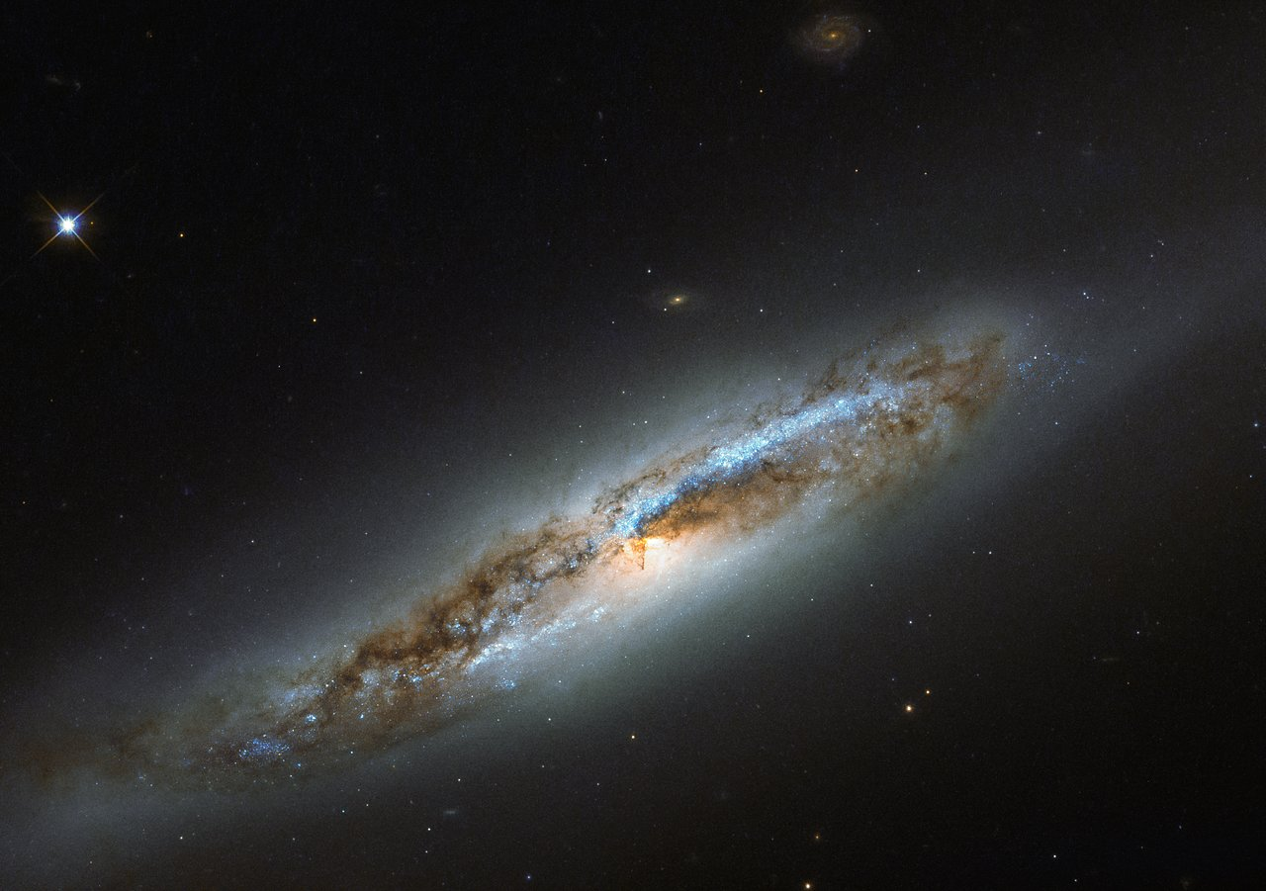
Jeremiah 9.23,24
NASB95
Thus says the LORD, “Let not a wise man boast of his wisdom, and let not the mighty man boast of his might, let not a rich man boast of his riches; but let him who boasts boast of this, that he understands and knows Me, that I am the LORD who exercises lovingkindness, justice and righteousness on earth; for I delight in these things,” declares the LORD.

Slide 3
Jeremiah 9.23,24
NASB95
Thus says the LORD, “Let not a wise man boast of his wisdom, and let not the mighty man boast of his might, let not a rich man boast of his riches; but let him who boasts boast of this, that he understands and knows Me, that I am the LORD who exercises lovingkindness, justice and righteousness on earth; for I delight in these things,” declares the LORD.

Slide 4
REVELATION 4.8
And the four living creatures, each one of them having six wings, are full of eyes around and within; and day and night they do not cease to say, “HOLY, HOLY, HOLY IS THE LORD GOD, THE ALMIGHTY, WHO WAS AND WHO IS AND WHO IS TO COME.”
NASB95

Slide 5
REVELATION 4.8
And the four living creatures, each one of them having six wings, are full of eyes around and within; and day and night they do not cease to say, “HOLY, HOLY, HOLY IS THE LORD GOD, THE ALMIGHTY, WHO WAS AND WHO IS AND WHO IS TO COME.”
NASB95

Slide 6
God is Holy
Understanding God Better:
A Study In Lev. 10 and Num. 20

Slide 7
What Does It Mean to Be Holy - Leviticus 10
Background
Lev. 8 & 9 – Consecration of the Priests
Lev. 9.15-21 – Aaron sanctifies the people
Lev. 9.22-24 – God shows His approval

Slide 8
What Does It Mean to Be Holy - Leviticus 10
Lev. 10.1-3
Why does God react this way?
Failed to Treat God as HOLY! (vs. 3)
How? (Defining what it means to be “Holy”)

Slide 9
Sacredness of Holiness – Leviticus 10
How MUCH does God cares…
Lev. 10.6,7
NOT allowed to mourn
NOT allowed to attend funeral/burial
”For the Lord’s anointing is on you” (HOLY)

Slide 10
Sacredness of Holiness – Leviticus 10
Num 3.3 These are the names of the sons of Aaron, the anointed priests, whom he ordained to serve as priests. 4 But Nadab and Abihu died before the LORD when they offered strange fire before the LORD in the wilderness of Sinai; and they had no children.
NASB95

Slide 11
Sacredness of Holiness – Leviticus 10
Num. 26.60 To Aaron were born Nadab and Abihu, Eleazar and Ithamar. 61 But Nadab and Abihu died when they offered strange fire before the LORD.
NASB95

Slide 12
Sacredness of Holiness – Numbers 20
Num. 20.2-13
WHY is God so Severe? (Num. 12.3)
WHAT did Moses do wrong?
Vs. 12,13

Slide 13
Sacredness of Holiness – Numbers 20
Num. 20.2-13
Ps. 106.32,33; Deut. 3.26; 4.21

Slide 14
Sacredness of Holiness – Ps. 106.32,33
They also provoked Him to wrath at the waters of Meribah,
So that it went hard with Moses on their account;
Because they were rebellious against His Spirit,
He spoke rashly with his lips.
NASB95

Slide 15
Sacredness of Holiness – Ps. 106.32,33
They also provoked Him to wrath at the waters of Meribah,
So that it went hard with Moses on their account;
Because they were rebellious against His Spirit,
He spoke rashly with his lips.
NASB95

Slide 16
Sacredness of Holiness – Ps. 106.32,33
They also provoked Him to wrath at the waters of Meribah,
So that it went hard with Moses on their account;
Because they were rebellious against His Spirit,
He spoke rashly with his lips.
NASB95

Slide 17
Sacredness of Holiness – Deut. 4.21
“Now the LORD was angry with me on your account, and swore that I would not cross the Jordan, and that I would not enter the good land which the LORD your God is giving you as an inheritance.
NASB95

Slide 18
Sacredness of Holiness – Deut. 3.26
²⁶ “But the LORD was angry with me on your account, and would not listen to me; and the LORD said to me, ‘Enough! Speak to Me no more of this matter. ”
NASB95

Slide 19
Sacredness of Holiness – Numbers 20
Num. 20.2-13
Ps. 106.32,33; Deut. 3.26; 4.21
WHAT did Moses Do Wrong?
“Shall we bring forth water…”
Equates himself and Aaron with God

Slide 20
Sacredness of Holiness – Numbers 20
Num. 20.2-13
Ps. 106.32,33; Deut. 3.26; 4.21
Num. 27.14; Deut. 32.51

Slide 21
Sacredness of Holiness – Numbers 20
Num. 20.2-13
Ps. 106.32,33; Deut. 3.26; 4.21
Num. 27.14; Deut. 32.51
Analogy: The Sacrifice of a Life

Slide 22
Do We Treat God as HOLY?
Ezek. 20.39-44
Elders in Exile (Ezek. 20.1-8; 14.1-5)
Idols in their hearts (Ezek. 14.4; 20.16)
What’s in OUR HEARTS? (1 Pet. 3.15)
Ezek. 22.26; 44.23
We making the DISTINCTION? (1 Pet. 2.9)

