Slide 1
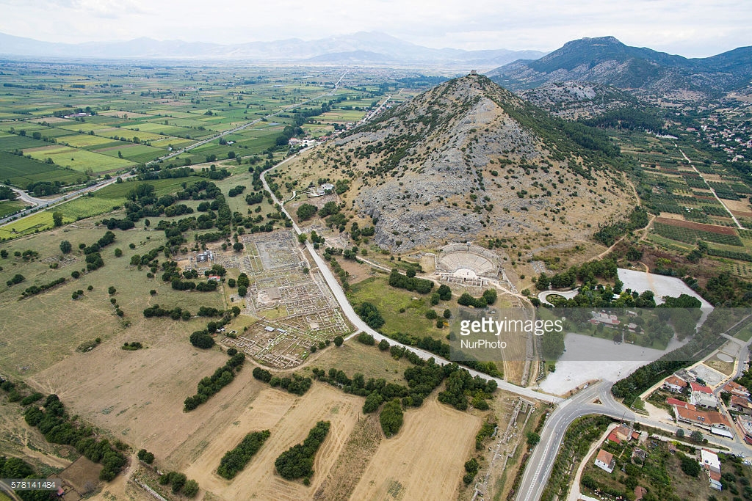
The Philippian Mind
“It’s not easy for us in the Western world today to imagine what it must have felt like to belong to a small community of ‘citizens of heaven’ in one of the eastern provinces of the Roman Empire in the 1st century. Gentile & Jewish Christians found themselves transplanted into membership in a new society that enjoyed no high esteem in the neighborhood, & they discovered that membership in it involved, in some important respects, a breach with the society to which they had previously belonged. The society… might be described as “crooked & depraved” but the congregation was commended for shining there “like stars in the universe” & offering it “the word of life” (Php 2:15-16).
A mission statement for congregations:
Standing firm in one spirit, with one mind striving together for the faith of the gospel
Php 1:27

Slide 2
Philippians
Ch1: Joy In Circumstances (The Single Mind)
Ch2: Future Plans (The Submissive Mind)
Ch3: False Teachers (The Spiritual Mind)
Ch4: Final Instruction (The Secure Mind)
1) Saints enjoying participation in the gospel [1:3-7]
2) Servants helping the progress of the gospel [1:12; 18b-20]
3) Soldiers ensuring the promotion of the gospel [1:27]
Conduct worthy of the gospel is not merely purity,
IT IS ACTIVE PROGRESS. Are we striving at proclaiming?

Slide 3
Philippians
Ch1: Joy In Circumstances (The Single Mind)
Ch2: Future Plans (The Submissive Mind)
Ch3: False Teachers (The Spiritual Mind)
Ch4: Final Instruction (The Secure Mind)
The group must have humility towards others. [2:1-5]
Learn from Saul, don’t lose sight of our true size… [1Sam 15:10-19]
See others as more important; do not seek our own.
1 Cor 13:5

Slide 4
Philippians
Ch1: Joy In Circumstances (The Single Mind)
Ch2: Future Plans (The Submissive Mind)
Ch3: False Teachers (The Spiritual Mind)
Ch4: Final Instruction (The Secure Mind)
One group focused on heavenly things. (3:12-16) The other group focused on earthly things. [3:17-4:1]
Their end is destruction. Their appetite becomes their god. v19
We must guard against earthly thinking.
Each local church might be compared to a garden planted in a wilderness, but the church’s concern was not so much to prevent the wilderness from encroaching on the garden as to see to it that the garden took over more & more of the wilderness. The garden was not to be “walled around”; its boundaries were to be flexible & expandable. To change the figure, each colony of heaven was to extend its territory & incorporate more & more of its neighborhood. Every church was to be a missionary church, & the history of the expansion of early Christianity shows that many churches realized & fulfilled this mission. Among those that did so the church of Phillippi holds an honored place.

Slide 5
Philippians
Ch1: A Single Mind For the Gospel
Ch2: A Submissive Mind Toward Others
Ch3: A Spiritual Mind Looks Upward
Ch4: Final Instruction (The Secure Mind)
Peace beyond understanding is attainable. We must have the right mindset [4-7, 8-9].
Good minds are contagious & influence conduct.
A secure mind enjoys salvation.

