Slide 1
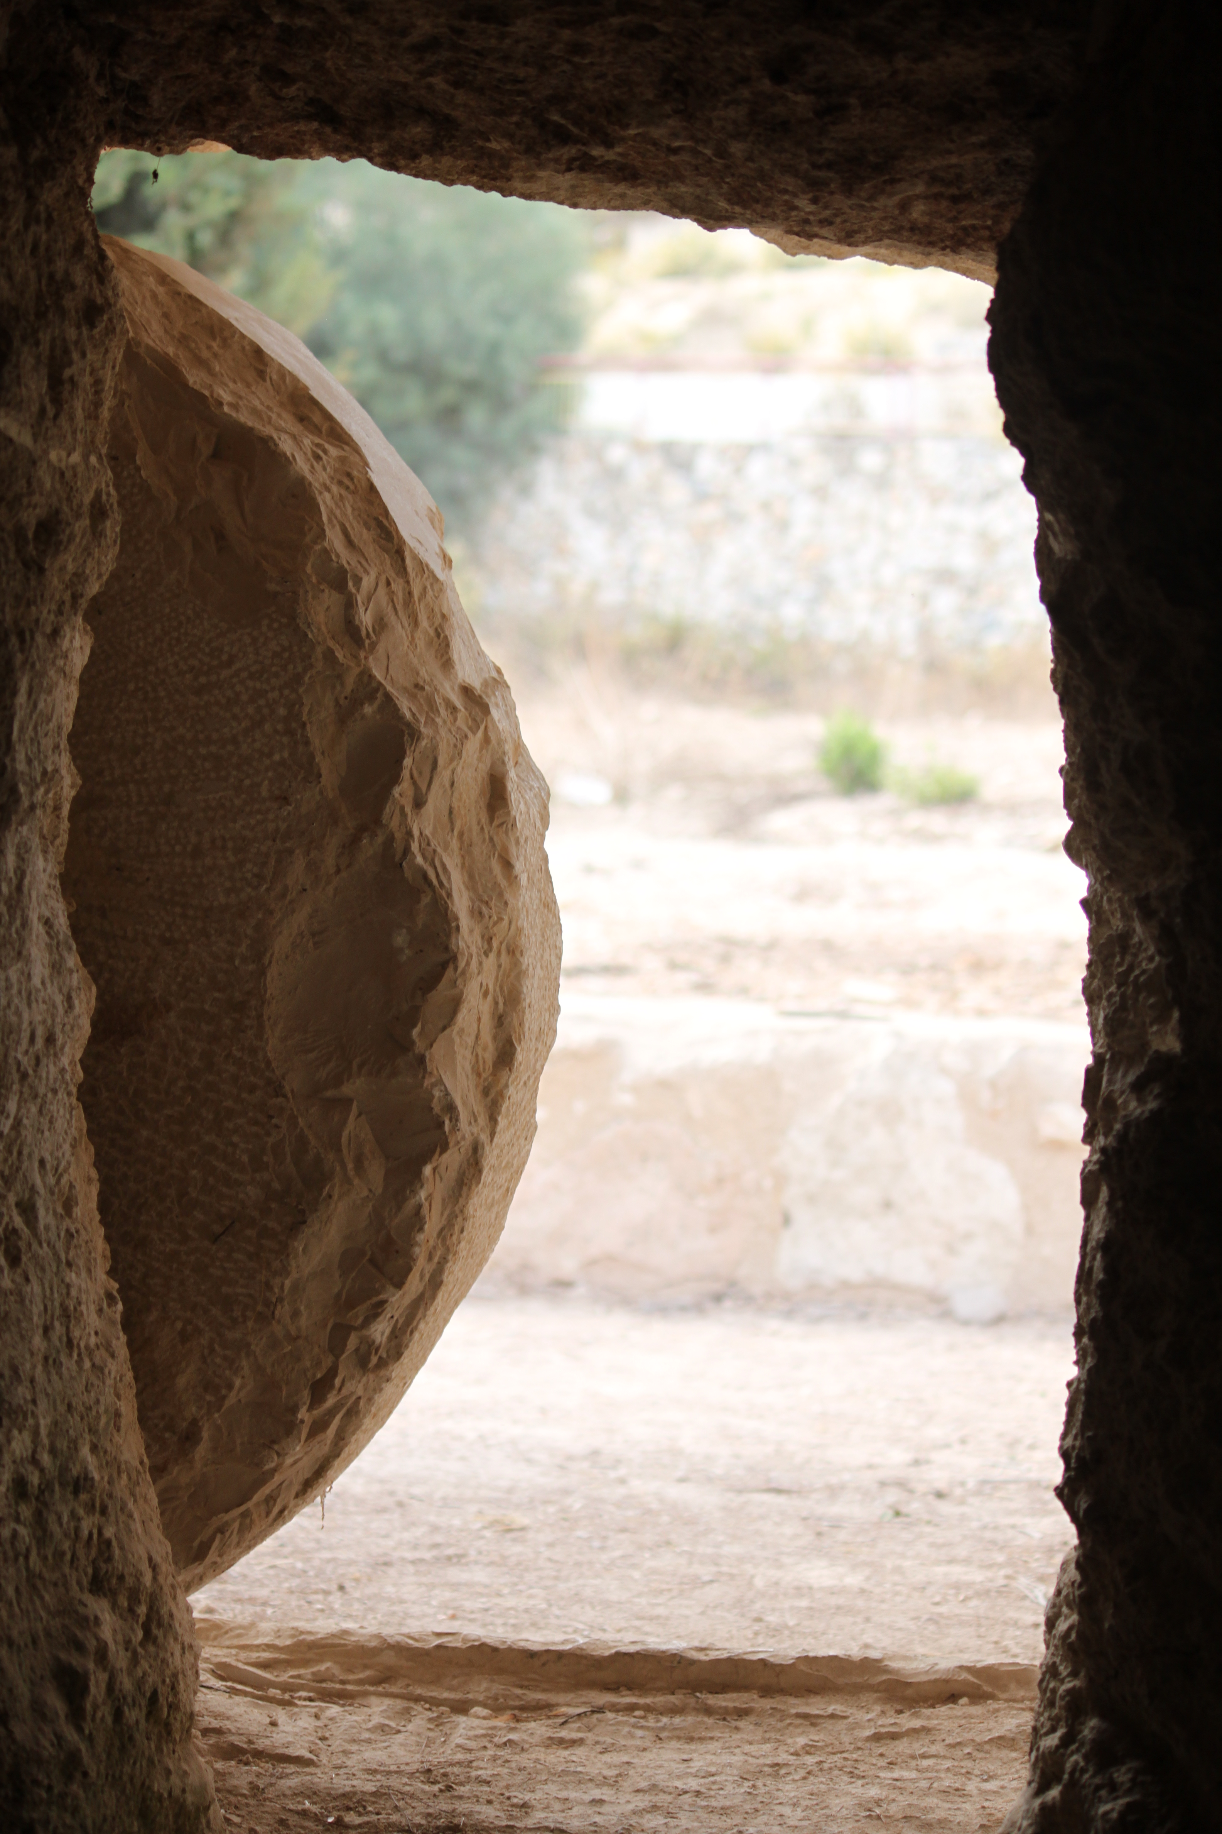
Raised The Third Day
An investigation into a frequent question from
1 Corinthians 15:3-5

Slide 2
Raised The 3rd Day, 1 Cor 15
1) Why that day? What scripture? 1 Cor 15:4
Jesus repeatedly predicts the 3rd Day. [Mt 16:21; 17:23; 20:17-19]
He also predicts the sign of Jonah [Mt 12:39-40]
The Temple Cleansing includes it [Jn 2:19-21]
Enemies guard the tomb b/c of this [Mt 27:63-64]
4 more unique ones in [Luke 24:7, 21-23, 46; Ac 10]

Slide 3
Raised The 3rd Day, 1 Cor 15
“The Holy One, blessed be he, never leaves
the righteous in distress for more than three days.”
(Gen. Rab. 91:6-7)
1) Why that day? What scripture? 1 Cor 15:4
3rd day predictions occur +13x in the NT.
2) But why & what OT passage? (+33x in OT)
[Hos 6:2] Never quoted in NT, but in Tertullian
[Jon 1:17] suggested due to Mt 12/Lk11
Other intriguing verses: 2Ki20; Lev 7, 19
Because of this, a Rabbinic Tradition developed…

Slide 4
Raised The 3rd Day, 1 Cor 15
“Enzymes within the body are released, causing cells to digest themselves and chemicals from stomach acids and tissues. The decaying tissues release green substances and gases, discoloring the body and causing it to bloat. Fluid oozes from the mouth or nostrils, and there is a terrible odor caused by gases produced by bacterial metabolism. All of these factors drastically alter the appearance of the deceased’s face and body. Depending upon climate and other conditions, these early signs of decomposition begin four to six days after death.”
Essential Forensic Biology -A. Gunn, 2006
1) Why that day? What scripture? 1 Cor 15:4
3rd day predictions occur +13x in the NT.
2) But why & what OT passage? +33x in OT!
The rich data created a strong Rabbinic Tradition.
But also a legal reason & distinction from a coma:
“For three days the spirit of deep mourning seizes the mourner. Why? B/c the features of the deceased’s face still are to be discerned.”
Death was only obvious with visible defects.
Legal Process for Identifying the Dead:
“They derive testimony concerning the identity of a corpse only from the appearance of the whole face with the nose… They give testimony about the identity of a corpse only during a period of three days after death.” (Lev Rab 18:1)

Slide 5
Raised The 3rd Day, 1 Cor 15
1) Why that day? What scripture? 1 Cor 15:4
2) Strong OT tradition & (3) Legal Reason...
BUT, does this date to the time of Jesus?
[Jn 11:39] Note Jesus’ arrival to resurrect Lazarus. The women aren’t worried about Jesus’ tomb [LK 23:55]
So, in Jesus’ day, raised the 3rd day = prior to decomposition.
(4) Which explains NT fascination w/ Psm 16:10
Found in primarily in Acts 2:27 & [13:32-39]
“By affirming that Christ was raised on the third day, the gospel focused attention on the fact that Jesus was not subject to the fleshly corruption that symbolizes the sinfulness of human beings generally. His death was sacrificial, atoning for the sins of others, while He himself was righteous.”
(Marty Pickup, unpublished paper at ETS, March 2011 Atlanta, GA)

