Slide 1
TAKE TIME TO BE HOLY

Slide 2
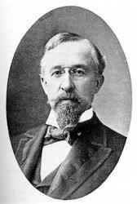
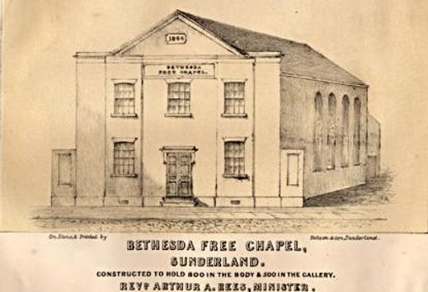
Take Time To Be Holy
Author, businessman, William Dunn Longstaff
Early supporter of Bethesda Free Church

Slide 3
Take Time To Be Holy
A) Take time to be holy, speak oft with thy Lord;
1) We must choose to give our time to growth. [1Th 3:12, 4:1, 9-10] 2) We must not give up on prayer. Pray w/o ceasing. 1 Thess 5:17
B) Abide in Him always, and feed on His Word.
1) We must always credit Him for growth. [Colossians 2:18-19] 2) We must recognize our need for the bread of life. John 6:35
C) Make friends of God’s children, help those who are weak,
1) Are we assembling & cultivating fellow faith co-workers? Heb 10 2) A hallmark of God’s character. E.g. Good Samaritan, Gala 6:9
D) Forgetting in nothing His blessing to seek.
Keep Him in EVERYTHING we do. He can bless it all. [Eph 3:14-21]

