Slide 1
The Letters to Asia
What can we learn?
‘Book of Life’ [Ex 32:30-35]
[Ps 69:22-36] cf. Lk 10:20

Slide 2
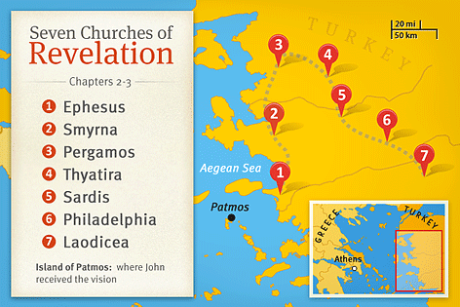
The Churches of Asia
Revelation 1:
v1 God revealed this to Jesus who gave it to John.
v3 This prophecy/revelation is supposed to BLESS.
v4 The 7 churches are to be a kingdom of priests. v6
v12-20 John’s humbling visit with Jesus. [v12-16]
Ch1 Is the historical context of The Revelation. Much of Ch1 is in Ch2-3 which occurs again in Ch20.

Slide 3
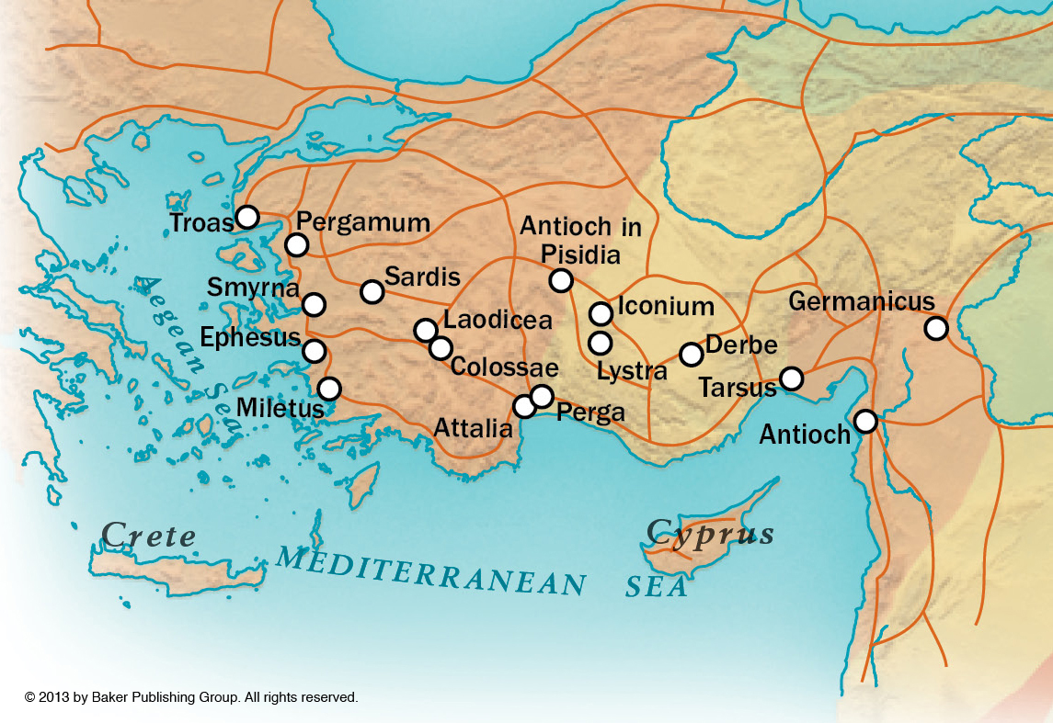
The Churches of Asia
Roman Roads In Asia Minor

Slide 4
The Churches of Asia

Slide 5
The Churches of Asia

Slide 6
The Churches of Asia

Slide 7
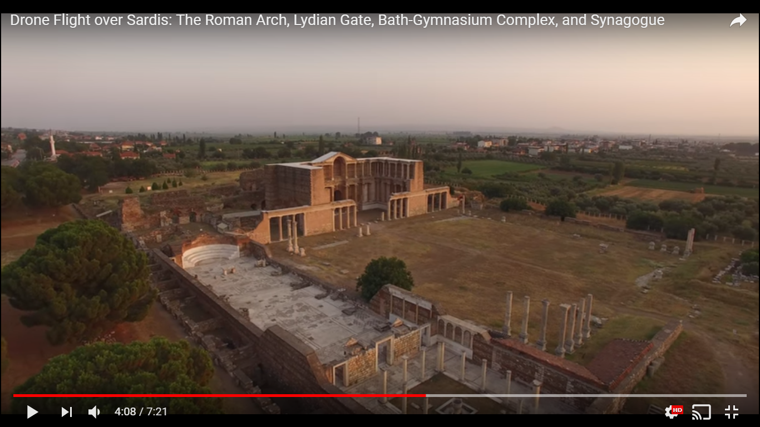
The Churches of Asia

Slide 8
The Churches of Asia

Slide 9
The Churches of Asia

Slide 10
The Churches of Asia

Slide 11
The Churches of Asia

Slide 12
The Churches of Asia

Slide 13
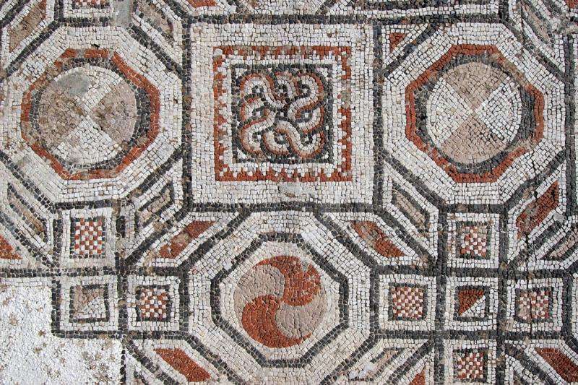
The Churches of Asia

Slide 14
The Churches of Asia
Sleepy Sardis
Jesus’ Powerful Presence Among the churches. What about us?
Their Need For Introspection Will my reputation save me?
Their Need For Progress Am I improving/advancing?
“Hold Firm” to what we First Heard & Believed
Jesus’ Judgment Will Come Suddenly It won’t be humorous.
Reality & Reward for the Righteous Remnant
Listen & Understand The Sword of The Spirit

