Slide 1
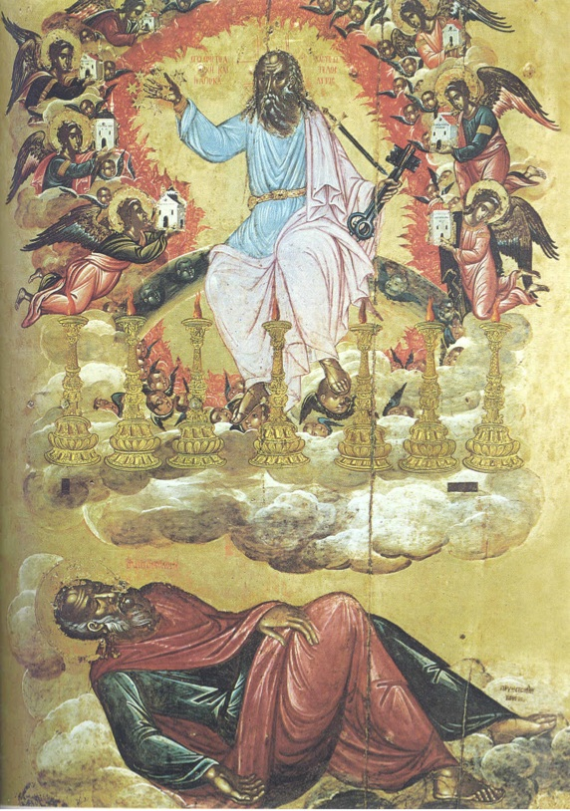
God’s Revelation to John
…from Jesus Christ, which God gave him… …made known by sending an angel…

Slide 2
Intro to The Revelation
1) What? Blessed is he who…
READS… because it is a letter to NT churches. HEARS… b/c it was a prophecy to NT churches. HEEDS… b/c it’s an apocalyptic message to NT…
WHY New Testament churches? Things which soon must take place… [1:1,3] NOTE: Dan 12:4 ‘conceal’ & Rev 22:10 ‘reveal.’
App: This book is as relevant as ALL the NT books!

Slide 3
Intro to The Revelation
WHAT? The book is a BLESSING.
WHO wrote it & WHEN?
John, a fellow partaker in suffering. [1:9] Either written ‘Early’ (60s) OR ‘Late’ (90s). BOTH views have pros & cons. The BLESSING isn’t dependent on the date!
Read this book like other bible books…

Slide 4
Intro to The Revelation
WHAT? The book is a BLESSING.
WHO & WHEN? John prior to 100AD.
HOW was it written?
An apocalypse reveals God’s Judgment.
A prophecy to edify, exhort, & console. 1Co14:3
A letter to seven unique NT churches.
WHERE does John get his ideas?

Slide 5
Intro to The Revelation
One estimate is 278 OT allusions in 404 verses.
“A general lack of knowledge of the prophetic portions of the OT might be one of the reasons brethren have felt so uneasy in the book of Revelation.” –F. Jenkins p. 18
WHAT? The book is a BLESSING.
WHO & WHEN? John prior to 100AD.
HOW? A prophetic letter revealing God’s will.
WHERE does John get his ideas?
The Spirit inspired it, but it also uses the OT. Don’t overlook that it also uses NT wording: Like Mt 24, Mk 13, Lk 21, 1-2 Th, 2 Pet & Jude.

Slide 6
Intro to The Revelation
Conclusion to the Prophecy 22:6-21 ‘Yes, I’m coming quickly.’ (22:10, 20)
‘Do not seal up the words of the prophecy of this book, for the time is near.’
So, why is there confusion? 4 Approaches:
‘Write, therefore, what you have seen [preterist], what is now [spiritual], & what will take place later [futurist].’ (1:19)
Keep in mind [Prov 18:17]. Be humble & cautious.
1) Historicist, a prediction of church history.
2) Preterist, events were fulfilled near to John’s time.
3) Futurist, events are in the process of fulfillment.
4) Spiritual, illustrating principles for ALL time.

