Slide 1
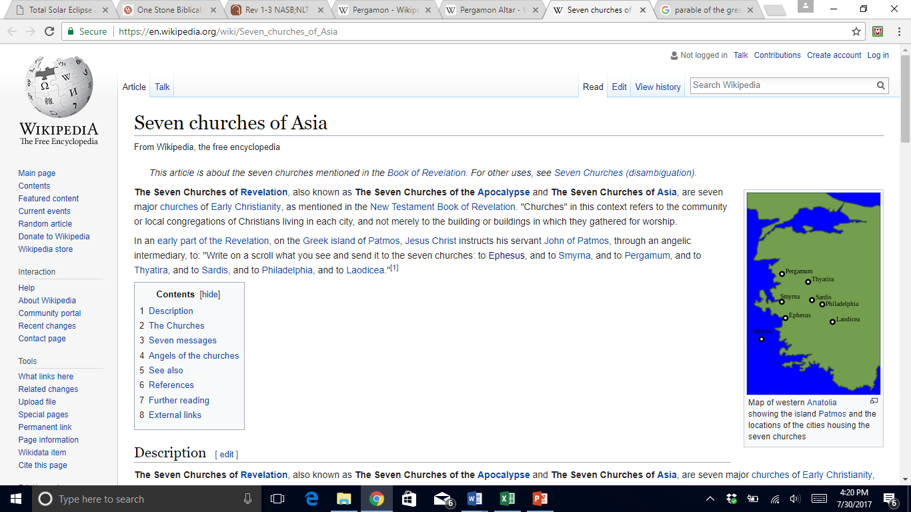
The Letters to Asia
What can we learn?

Slide 2
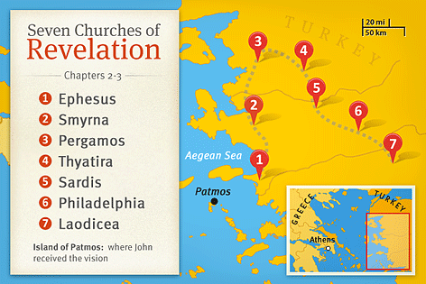
The Churches of Asia
Revelation 1:
v1 God revealed this to Jesus who gave it to John.
v3 This prophecy/revelation is supposed to BLESS.
v4 The 7 churches are to be a kingdom of priests. v6
v12-13 Jesus stands among the seven churches. [v17-20]
Ch1 Is the historical context of The Revelation. Much of Ch1 is in Ch2-3 which occurs again in Ch20.

Slide 3
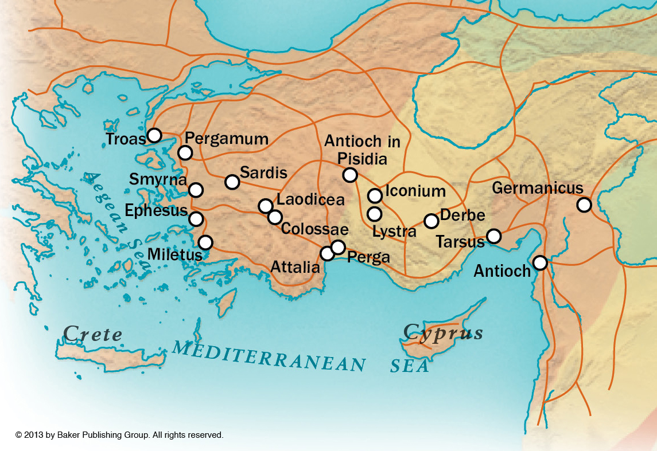
The Churches of Asia
Roman Roads In Asia Minor

Slide 4
The Churches of Asia

Slide 5
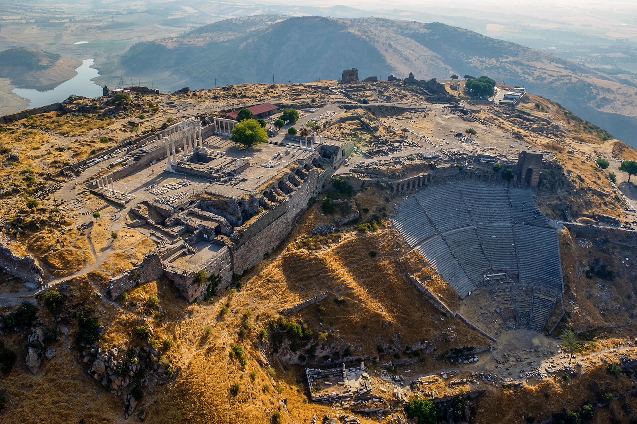
The Churches of Asia

Slide 6
The Churches of Asia
Pergamon Altar

Slide 7
The Churches of Asia

Slide 8
The Churches of Asia

Slide 9
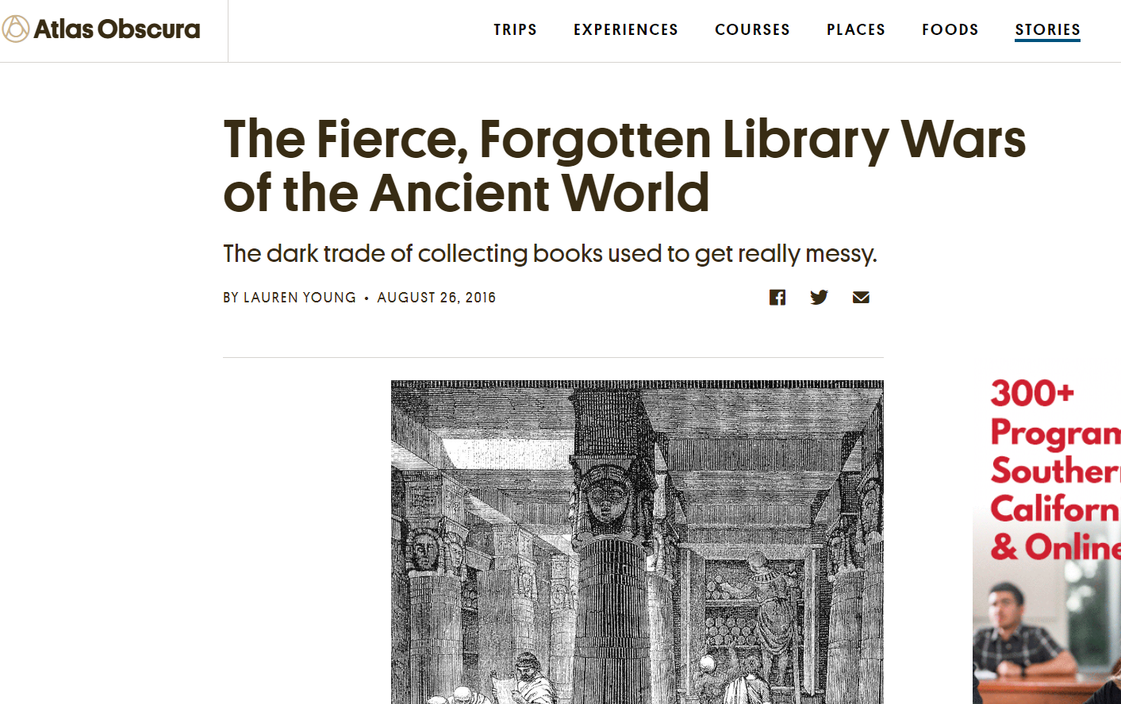
The Churches of Asia
They competed for the greatest collection of Homer’s works & the most accomplished Homeric scholars!

Slide 10
The Churches of Asia
Permissive Pergamum/Pergamon
Jesus’ Power Among the churches. What about us?
They Were Tempted But Loyal! We can do the same!
They Were Persecuted But Faithful! Will we do the same?
Permissive & Promiscuous Literal or figurative, not good.
They Need To Repent! Or Jesus himself will war against us!
They Need The Bread of Heaven! Jn6; Ps78; Lk 14:15-24
They Needed A New Name! [22:3-5] Will we hold the white stone?

