Slide 1
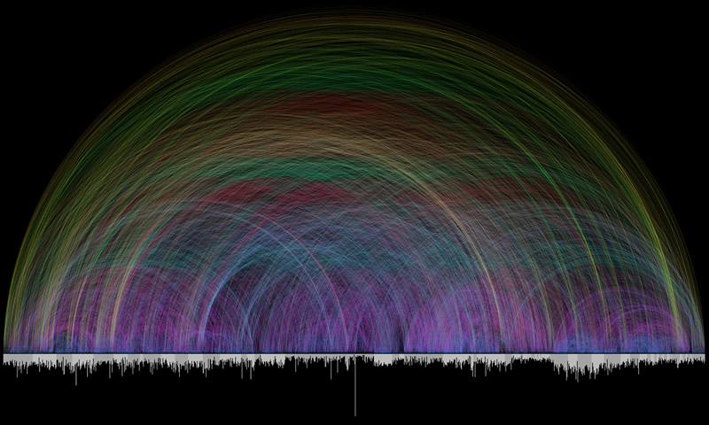
Connections from
Genesis to Revelation

Slide 2
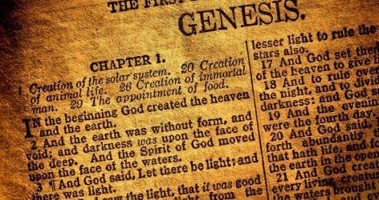
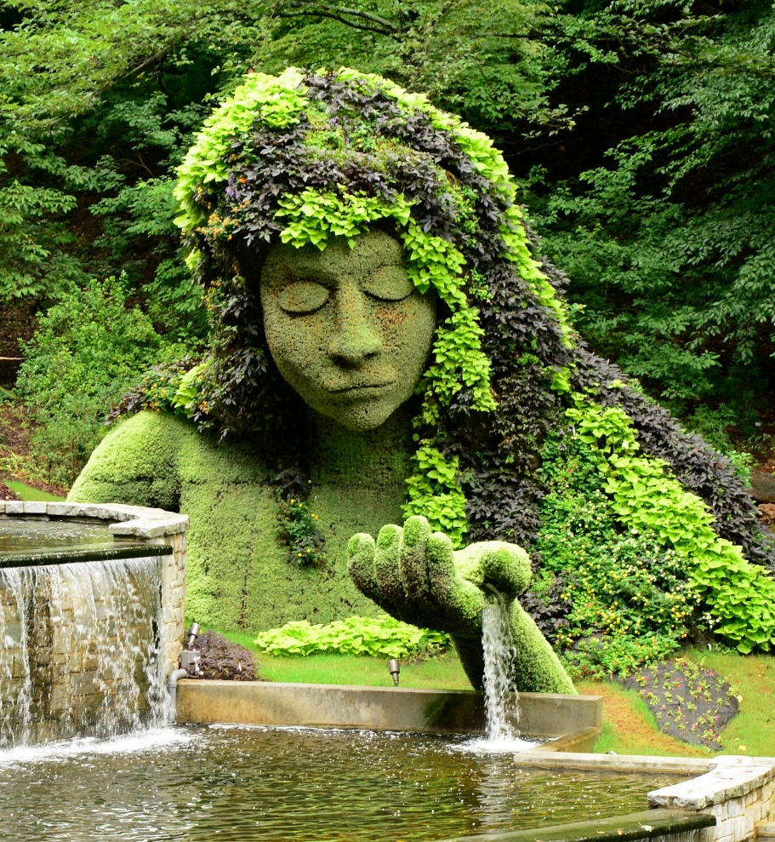
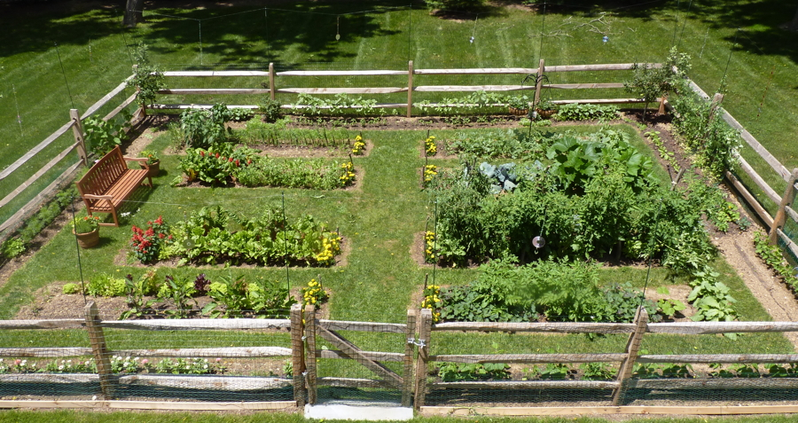
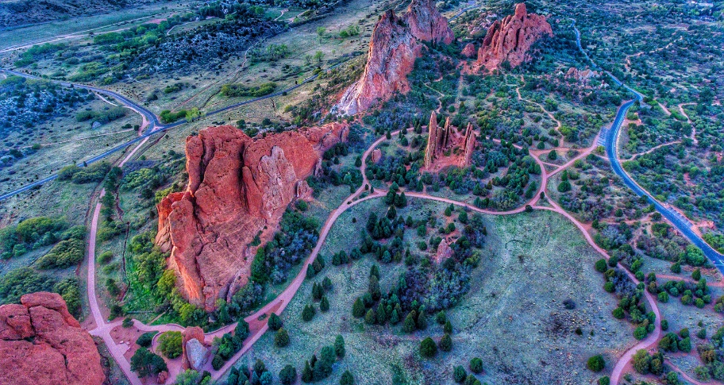
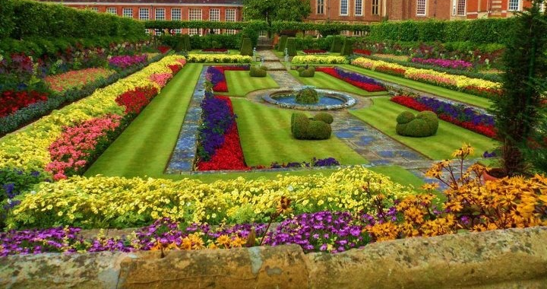
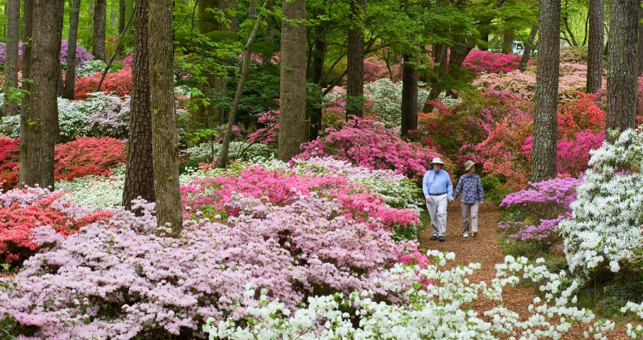
In the beginning God created…
The Garden

Slide 3
God the Gardener
What images come to mind when we read ‘Garden’?
What was it like to hear God walk there?
What activity was decreed for Adam & Eve?
work & care (NIV) cultivate & keep (NASB) dress & keep (KJV) work & keep (ESV)

Slide 4
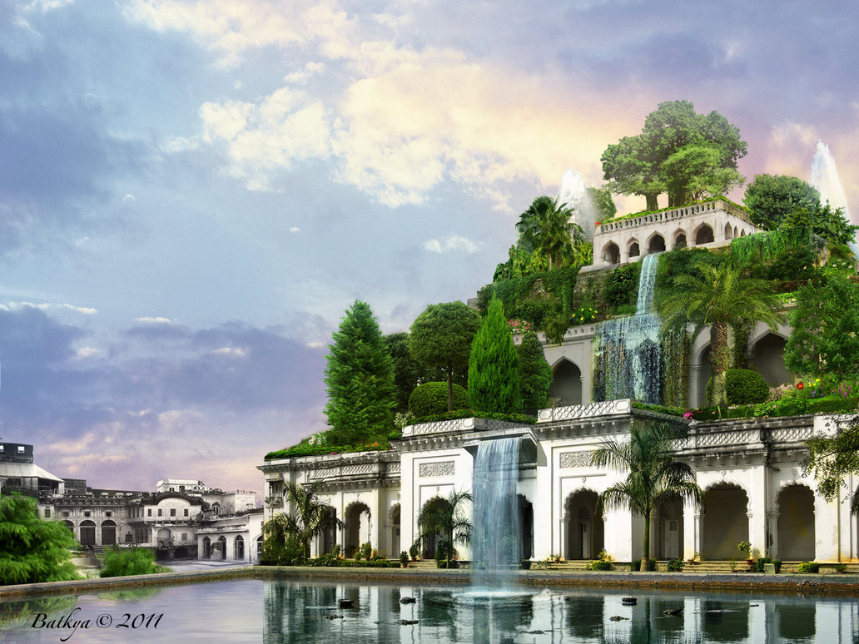
God the Gardener
How to define the Garden:
“Elevated” isn’t out of the question. Ezk 28:13-14 “Well watered place” is more likely. 4 Canals?
Calling it Paradise isn’t wrong. Stems from LXX.
The Flood prevented any hope of finding its location.
“Work & Keep” may be more than we think:
The words & grammar suggests service to God.

Slide 5
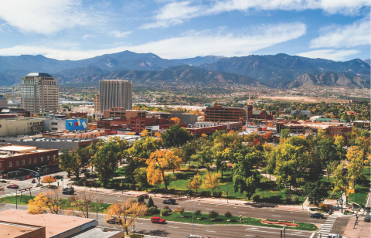
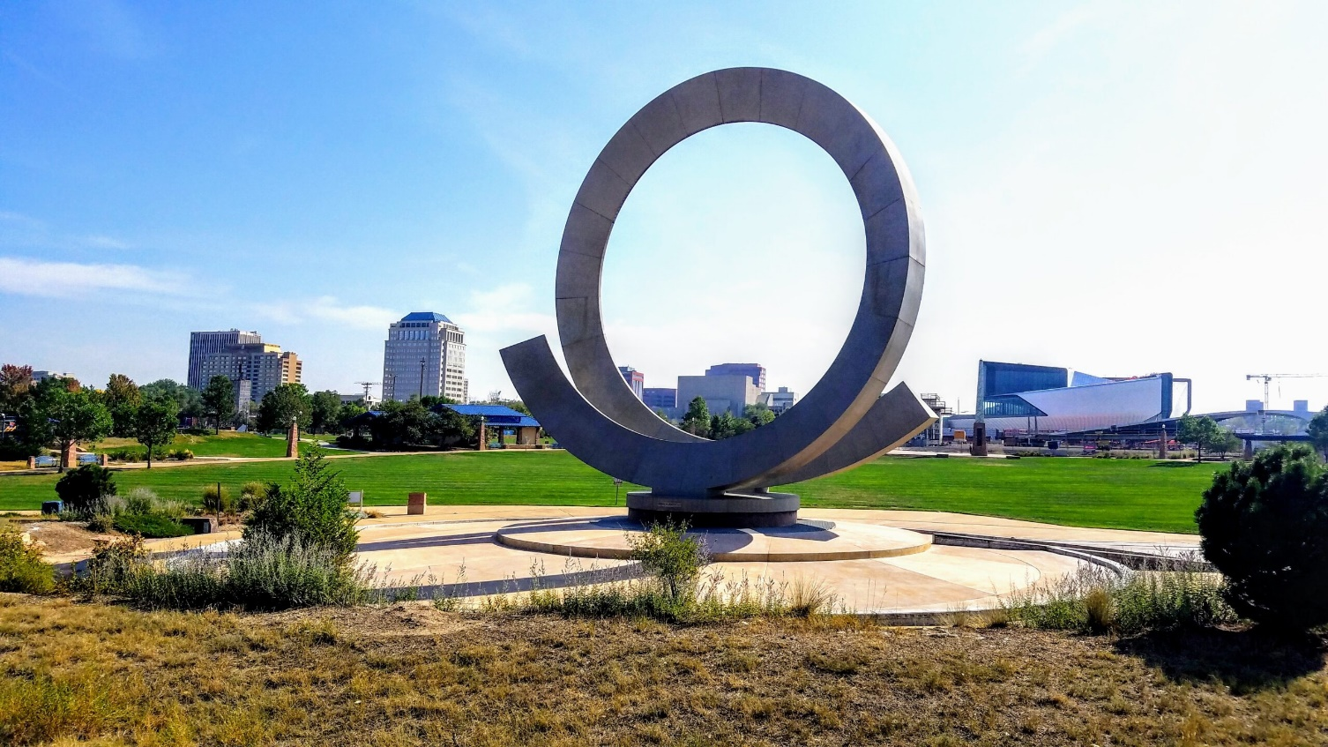
God the Gardener
The IDEA of ‘Priestly Service’ Highlights The Following:
1) The presence of God in Eden & later The Temple
2) Temple items reflect images in Eden. EG The Lampstand
3) Floral & fruitful art are found throughout The Temple.
4) Temple entrance was in the East & protected by cherubim.
5) The Temple was built on a mountain, Mt Zion.
6) The Temple of Ezekiel & Revelation has a miraculous river.
7) Some even outline a 3-part structure in both.
“Man has always carried deep within his soul a longing for something that seems to be just beyond his grasp—something he is sure will make him happy… however much delight these things may bring to his life, the longing is still there, always just out of grasp it seems.
It is a longing for Eden. It is man’s longing for that joy & happiness that he had in the presence of his Creator before sin destroyed the union & drove man from the presence of God. Or, to put it another way, it is a longing for heaven, Paradise regained, where we will finally be brought back to the tree of life to dwell in the presence of him who made us.” (Phil Roberts)

Slide 6
God the Gardener
The Law & Prophets Also Use Eden:
Israel was well-watered like Eden [Deut 11:8-17]
Sadly, (Jer 4:23-27) says it returned to wilderness.
[Isa 51:1-3 & 61:11] Depicts God as a gardener.
And Ezekiel 36:35 says Eden will return!
The desolate land will become like… The Garden of Eden!

Slide 7
God the Gardener
Jesus Uses Garden Imagery
In several parables: The Soils & The Seed, The Mustard Seed, Wheat & Tares, etc. He got the ideas from OT plant parables.
He invites us to join the reapers for the harvest! And in JN 15, says our Father is The Master Gardener.
The Most Significant Comes at The End:
Like OT kings, He is laid in a garden tomb. [JN 19:40-42] And then Mary mistakes Him for… [JN 20:11-16]

Slide 8
God the Gardener
Paul Also Uses Garden Imagery
I planted, Apollos watered, God… 1 Cor 3:6 We’re to be firmly rooted in Christ Col 2:6-7 And produce fruit of The Spirit in us Gal 5:22ff
The Bible Ends Back In The Garden
Zech 14:11 There’ll be no more curse… [Rev 21:1-7, 22:1-4] A return to Eden, a place where God is, & sorrow has ceased!

