Slide 1
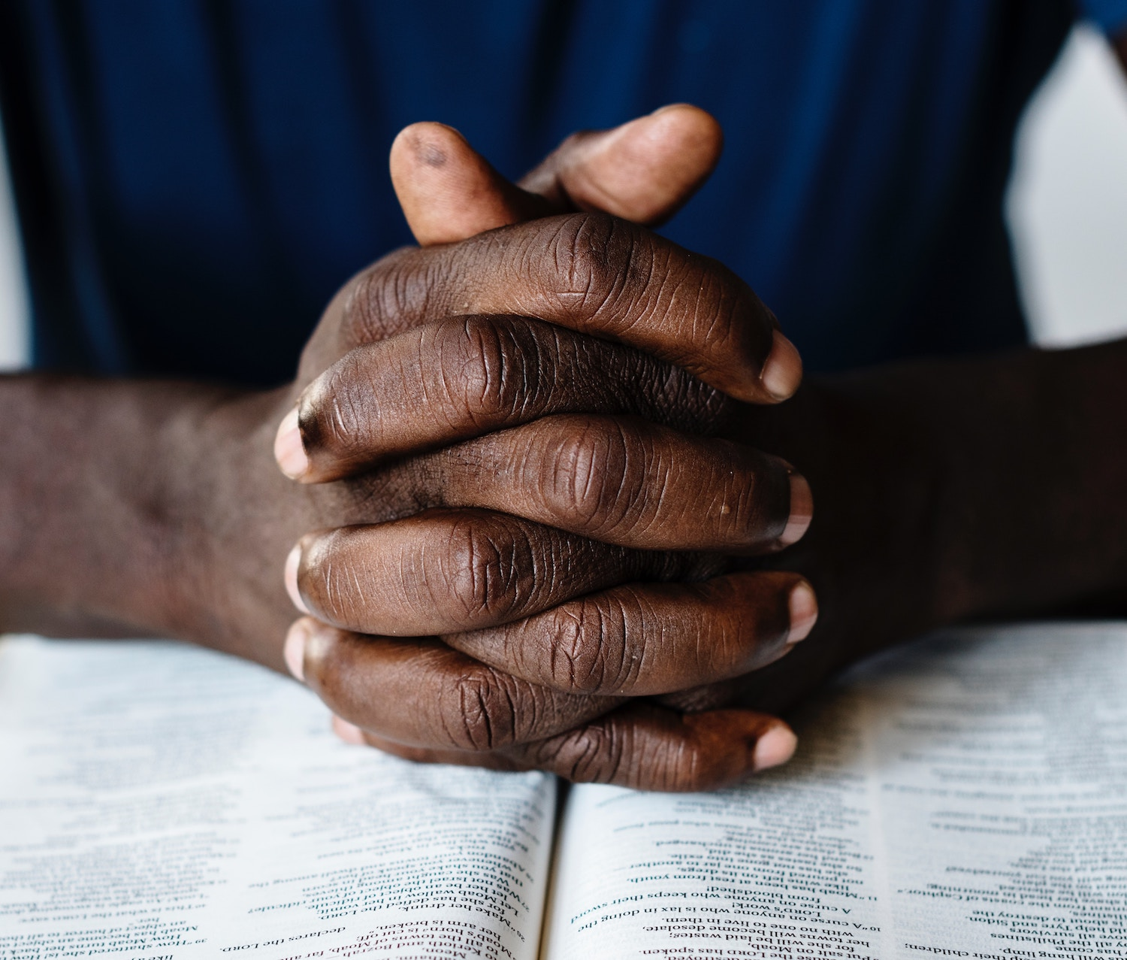
Devoted To Prayer Acts 2:42
The Prayer Paradox

Slide 2
The Paradox of Prayer
Embrace the paradox of prayer!
He is very distant & very near!
Gen 18:25 Lk 11:13
1) He Is Separate from Us: [Eccl 5:1-3,6-7] cf. Pro 10:19
In Holiness [Isa 6:1-7]
In Authority (Dan 4:3)
In Ability (Ezk 1 & 10; Job 38-42)
His Temple Deserves Silence Hab 2:20

Slide 3
The Paradox of Prayer
“The devil… sends errors into the world in pairs – pairs of opposites. And he always encourages us to spend a lot of time thinking which is the worse… He relies on your extra dislike of the one error to draw you gradually into the opposite one." -C.S. Lewis
Embrace the paradox of prayer!
1) He Is Distant or Separate From Us. [Isa 6:1-7]
2) He Is Close To Us: [Lk 11:9-13; 2 Chron 20:5-9]
He is described as our friend & our Father.
The judge is capable of intimacy/friendship.
Jesus leaned heavily on prayer to “the Father.” Paul encouraged the same [Gal 3:23-4:7]

Slide 4
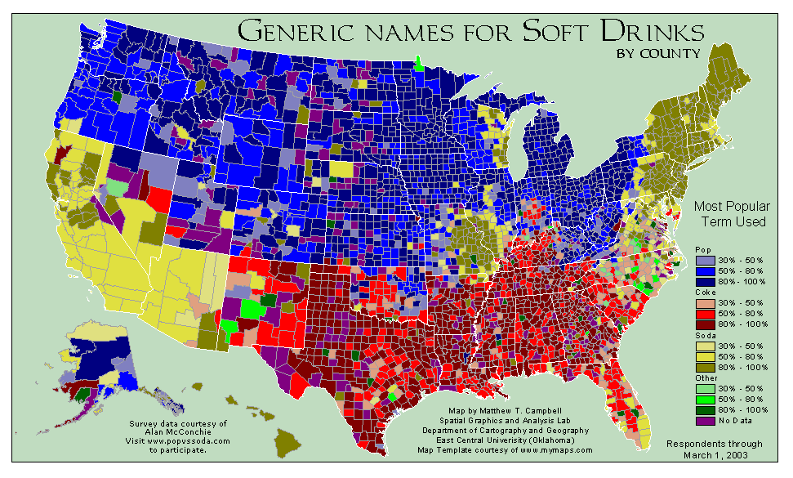
The Paradox of Prayer
1) He Is Distant or Separate From Us. [Isa 6:1-7]
2) He Is Close To Us: [Lk 11:9-13; 2 Chron 20:5-9]
3) What does it mean to call Him Abba? [Gal 3:23-4:7]

Slide 5
The Paradox of Prayer
1) He Is Distant or Separate From Us. [Isa 6:1-7]
2) He Is Close To Us: [Lk 11:9-13; 2 Chron 20:5-9]
3) What does it mean to call Him Abba? [Gal 3:23-4:7]
How do you refer to your ‘Paternal Figure’?
Don’t be a distraction in public prayer.
He’s looking at hearts above words [Mk10:13-16].

Slide 6
The Paradox of Prayer
"I cannot tell a lie, father, you know I cannot tell a lie! I did cut it with my little hatchet.'' The anger died out of his father's face, & taking the boy tenderly in his arms, he said: "My son, that you should not be afraid to tell the truth is more to me than a thousand trees! Yes - though they were blossomed with silver & had leaves of the purest gold!‘’ –A George Washington legend.
1) He Is Distant or Separate From Us. [Isa 6:1-7]
2) He Is Close To Us: [Lk 11:9-13; 2 Chron 20:5-9]
3) Like A Child, See Him As A Father [Gal 3:23-4:7]
Why kids lie? ‘Cherry Tree’ of ‘Cried Wolf’? 75% expected ‘Wolf’ to work. But ‘Tree’ stopped +66% of kids.

Slide 7
The Paradox of Prayer
1) He Is Distant or Separate From Us. [Isa 6:1-7]
2) He Is Close To Us: [Lk 11:9-13; 2 Chron 20:5-9]
3) Like A Child, See Him As A Father [Gal 3:23-4:7]
4) Speak To Your Father The Judge! [2 Chr 20:10-13]
He desires humility & honesty! Just as we’ve seen in the Psalms.
“God’s infinite greatness, which we would expect to diminish us, actually makes possible the very closeness that we desire. A God unbound by our rules of time has the ability to invest in every person on earth. God has, quite literally, all the time in the world for each one of us.”
–P. Yancey Prayer: Does It Make Any Difference (pg 49)

