Slide 1
God’s Incredible Story
Cities
Metals
Luke 24:44-45
Clothing
Gardens

Slide 2
Scripture & Stone
Using the 328 (+1) uses of ‘stone’ in scripture to the tell the gospel story to a seeker.

Slide 3
Scripture & Stone
Or perhaps they know other famous cultural stone stories!
Using the 328 (+1) uses of ‘
So, your child knows David’s story but where do you go from there?

Slide 4
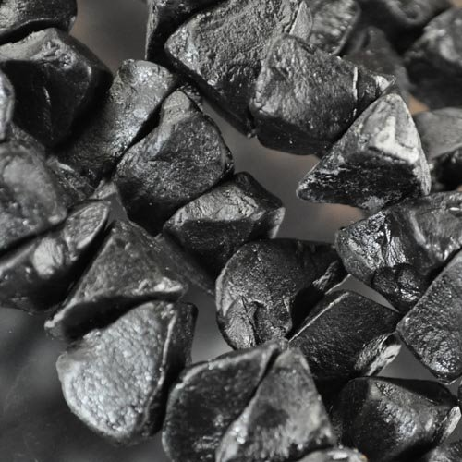
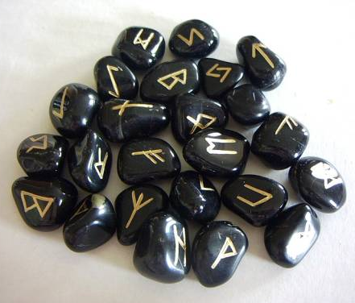
Scripture & Stone
Genesis has foundational stone references:
“Onyx” Stones were present at Eden: [Gen 2:10-14] Ex 25:7; 28:9-12; 28:15-21 & are often connected to The 12.

Slide 5
Scripture & Stone
Genesis has foundational stone references:
“Onyx Stones” were present at Eden: [Ge 2:10-14] Ex 25:7; 28:9-12; 28:15-21 & are often connected to The 12.
“Stones” were made by man at Babel: Gen 11:3; [Ex 20:25]; God favors uncut over carved creations.

Slide 6
Scripture & Stone
Genesis has foundational stone references:
“Onyx Stones” were present at Eden: [Ge 2:10-14] Ex 25:7; 28:9-12; 28:15-21 & are often connected to The 12.
“Stones” were made by man at Babel: Gen 11:3; [Ex 20:25]; God favors uncut over carved creations.
“Stones” are public testimony in Jacob’s stories: 28:11, 18-22; 29:1-10; 31:43-55; 35:14; 49:24

Slide 7
Scripture & Stone
Genesis has foundational stone references.
Joshua picks up on these stone tendencies:
4:1-9 Twelve public stones set up at Gilgal 8:30-32 Uncut stones at Mt Ebal & Gerazim Ch 15 boundary lines for Israel’s tribes 24:25-27 A witness to Israel’s covenant 10:8-11 Stones fall from heaven, meteorites!!
But also a new theme: 10:16-19, 26-27 Large stones were used to seal caves/tombs.

Slide 8
Scripture & Stone
Genesis has foundational stone references.
Joshua picks up on these stone tendencies.
Many ‘stone’ references could continue: Ezk 13x; Isa 11x; Jer/Lam 9x; Job 7x; Zech 6x Incredibly, Psm 3x & they’re the most known!
The NT has made Habakkuk 2:9-11 well-known. How is this passage fulfilled in the NT?

Slide 9
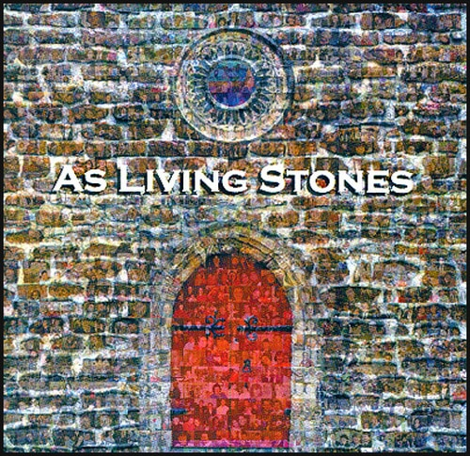
Scripture & Stone
How Do The Stones Cry Out? Hab 2:9-11
Onyx Stones return in The Temple 1 Chr 29 But that temple didn’t last long. Cf. Ez-Neh Psa 102:12-17 seeks God’s compassion on “Zion” & her stones. But what of [Mark 13:1-2]? Was God Not Gracious to Zion?
We’re now Zion’s stones! Heb 12:22 & 1 Pet 2:5 & a united church cries out God’s glory! Jn 17

Slide 10
Scripture & Stone
How Do The Stones Cry Out? Hab 2:9-11
A united church cries out God’s glory! Jn 17 Unity is found in The Cornerstone. [1 Pet 2:4-8]. We must have a sound foundation [Eph 2:19-22].
The gospel story paves the way: [Lk 19:36-41] The large stone was rolled away! A herald of heaven cried out, He Is Risen! Allow me one use of ‘rock’ [Mt 27:50-54]
Hear the conclusion in [Rev 21:10-21]

