Slide 1
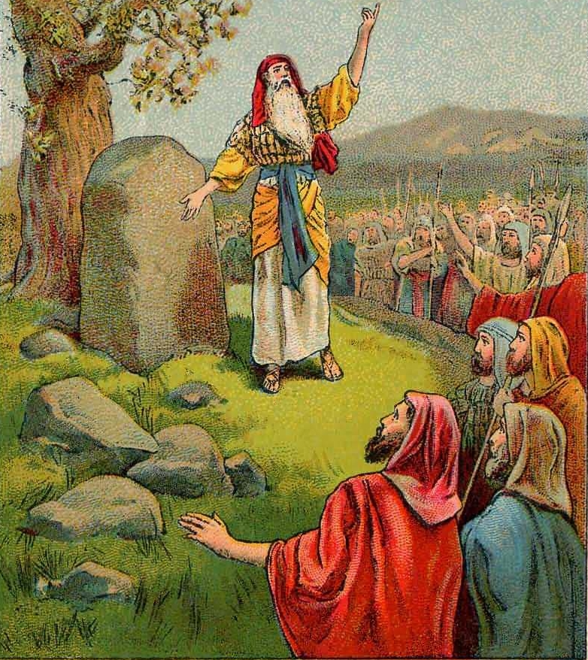
Avoiding Disaster Joshua 22-23

Slide 2
Avoiding Disaster (Joshua 22-23)
Joshua says farewell to the Eastern Tribes: [22:1-6]
What are we clinging to? Where is our loyalty? Is it obvious? Are we clinging to God’s heavenly provided armor?
Then a curious incident in the East occurs: [22:12]
Phineas & 10 others are “all in” for a religious fight! [v15-20]
The problem: It’s all based on a wrong assumption.
They failed to follow God’s Law of investigation. [Dt 13:12-18]
As Christians, we need calm conversations. Col 4:6

Slide 3
Avoiding Disaster (Joshua 22-23)
Joshua tells the East to CLING to God: [22:1-6]
Then a curious incident in the East occurs: [22:12]
The West has made a wrong assumption. [Dt 13:12-18]
Three Questions to ask ourselves for calm conversation:
1) Are we discussing preferences or God’s detailed dictations?
2) Are we treating others as ‘God’s Image’ or ‘Silly Strawmen’?
3) Do our assumptions need clarification?
The Reality: The East agreed & wants UNITY! [22:22-27]

Slide 4
Avoiding Disaster (Joshua 22-23)
Joshua tells the East to CLING to God: [22:1-6]
Then a confusing moment for UNITY occurs: [22:22-27]
Joshua’s 1st Farewell [23:5-8, 12-13, 14-16]
Largely echoes earlier scripture in Deuteronomy.
God will play His part, we must still obey Him.
Be careful being married to the world. It’s harder.
“God keeps His word” is both comforting & terrifying.

