Slide 1
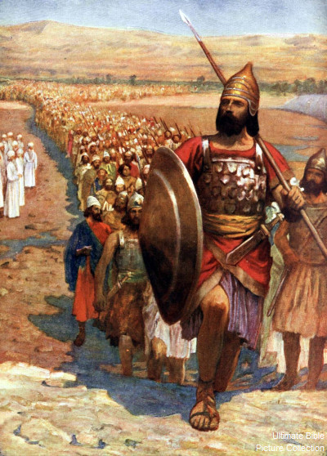
The 1st Two Battles Joshua 6-8
Don’t lose the child-like spirit enjoying the emotions of these stories!

Slide 2
The 1st Two Battles Joshua 6-8
“There are two kinds of people in the end: those who say to God, ‘Thy will be done,’ & those to whom God says, in the end, ‘Thy will be done.’ All that are in Hell, choose it. Without that self-choice there could be no Hell. No soul that seriously & constantly desires joy will ever miss it. Those who seek find. Those who knock it is opened.”
-C.S. Lewis The Great Divorce
1) The Battle Stories Create Hard Questions for Some
Why does a loving God desire they’re “utterly destroyed”? Consider ALL the verses, [Deut 20:17-18; Gen 15:13-16]
God was patient. They had decayed to child-sacrifice. Lev 18
God’s War Laws were merciful & just. [Dt 20:1-12; 13:12-18]
2) His Good Impartial Justice Should Stand Out The warning of [Josh 6:26] comes about in [1 Ki 16:34].
Notice the often overlooked 2nd battle [Josh 7:1-12, 19].

Slide 3
The 1st Two Battles Joshua 6-8
1) God gave good laws for war. [Dt 20]
2) God consistently executed the laws. [Josh 7]
3) What about when the innocent suffer?
Sometimes we suffer because of other’s sins. We aren’t robots.
In the end, God gives Israel the victory. [Josh 8:6-8]
Then Israel rightfully renews their covenant. [Josh 8:30-35] It includes blessings & curses; and it included foreigners!
4) What other lessons from these battles can we learn?

Slide 4
The 1st Two Battles Joshua 6-8
1) God gave good laws for war. [Dt 20]
2) God consistently executed the laws. [Josh 7]
3) Sometimes innocent suffering is from other’s sins.
4) What other lessons from these battles can we learn?
Leaders have initiative, they don’t sit back & wait.
Be careful about ‘selective memory’ nostalgia. [Josh 7:7]
Notice how Joshua avoids the Dt 21 Curse in [8:29]. The same curse that Jesus took on our behalf! Gal 3:13

