Slide 1
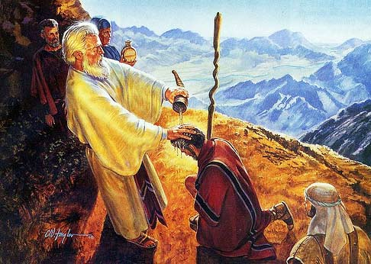
Joshua son of Nun’s Preparation for LEADERSHIP

Slide 2
Joshua’s Preparation for Leadership
Joshua experienced early success [Ex 17:8-16] God wants him to remember the victory. v14
Joshua was separated from the crowd [Ex 24:9-18] He avoided the calf [32:17-18] & stayed at The Tent 33:11
His convictions led to mistakes [Num 11:26-30] A real leader sees these as learning moments. 1 Tim 5:19
He supported Caleb [Num 13:27-31 & 14:5-10] Biblical leaders don’t have to weigh in on every issue. Shepherds value supporting others in their battles.

Slide 3
Joshua’s Preparation for Leadership
Joshua experienced early success [Ex 17:8-16]
Joshua was separated from the crowd [Ex 24:9-18]
His convictions led to mistakes [Num 11:26-30]
He supported Caleb [Num 13:27-31 & 14:5-10]
Chosen because he had The Spirit [Num 27:12-23]
Leaders, at home & church, need The List of Gal 5:22-26
Received encouraging words from Moses [Dt 3:21-28]
Gave birth to the rallying cry of [Joshua 1:1-5, 9]
But never forget, at 1st he failed, but he kept on maturing.

