Slide 1
Sunday Evening – February 18, 2018
Observing Diets and Days

Slide 2
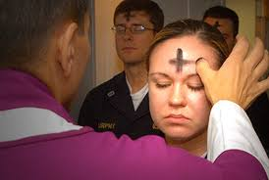
Observing Diets and Days
Observing “Lent”
A religious observance in 2018: Lent is Wednesday February 14 and ending Thursday March 29. Lent is followed by Good Friday and Easter Sunday.
As the season of Lent draws near, it is helpful to recall the discipline of the Church in regard to fast, abstinence, and other forms of penance. (Diocese of Pittsburg, 1995)
Meat is not eaten on the Fridays of Lent. (fish is permitted)
Lent is not found in the Bible. It is a doctrine of men.

Slide 3
Observing Diets and Days
Diets in the Bible
Herbs (Gen. 1:29)
Meat (Gen. 9:1-4)
Sacrifices (Lev. 7:6)
Clean and Unclean. (Lev. 11) “Consecrate yourselves, and you shall be holy for I am holy.
Fasting (Mt. 17:21; Acts 13:3)
Peter is commanded to eat by God (Acts 10)

Slide 4
Observing Diets and Days
Days in the Bible
Sabbaths (Ex. 20:8ff; Num. 28:9-10)
New Moons (Num. 10:10; 28:11)
3 Annual Feasts (Deut. 16:1-17)
Other days: Feast of Trumpets, Day of Atonement (Num. 29:1-11)

Slide 5
Observing Diets and Days
Let No Man Judge You
(Col. 2:11-13)
In regard to diets
In regard to days
Nothing bound by another; may be permitted by one’s conscience (Rom. 14)

Slide 6
Sunday Evening – February 18, 2018
Observing Diets and Days

